Slide 1








ECO SCHOOL EXCHANGE PROGRAM
IN COLLABRATION WITH
INTERNATIONAL URBAN AND REGIONAL COOPERATION
(IURC) ASIA AUSTRALISIA

Slide 2
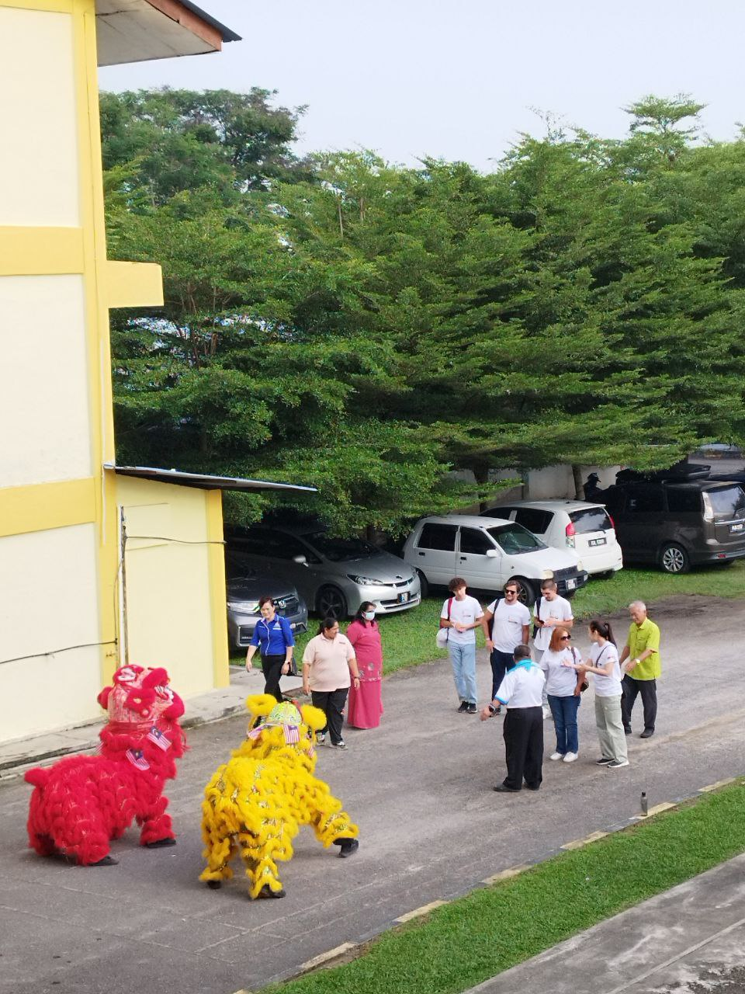
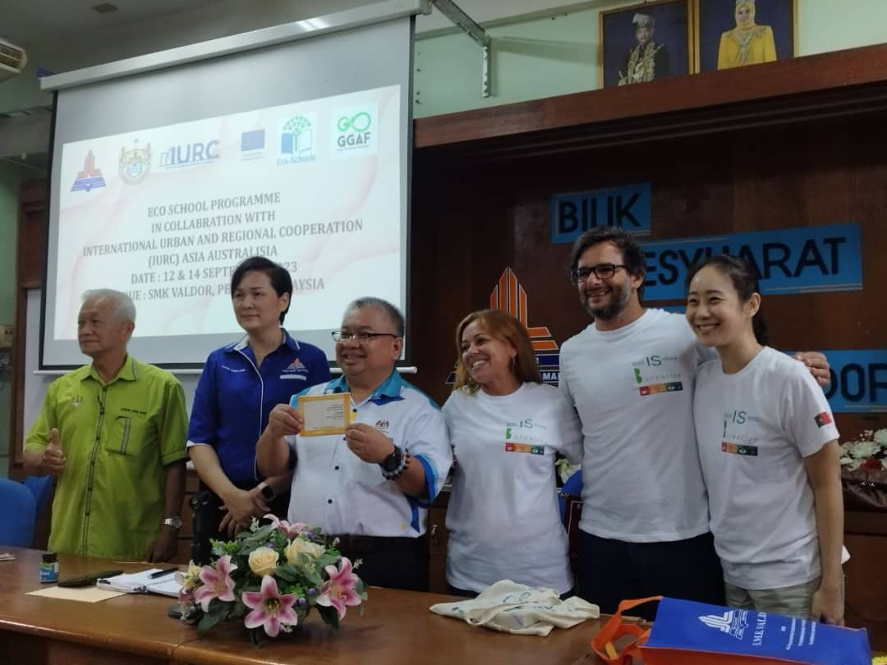
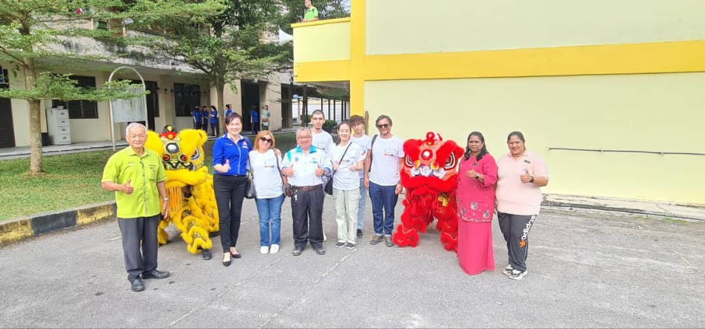
Olá Amigos!
valuable experience
learn new culture
get to know about their education system

Slide 3
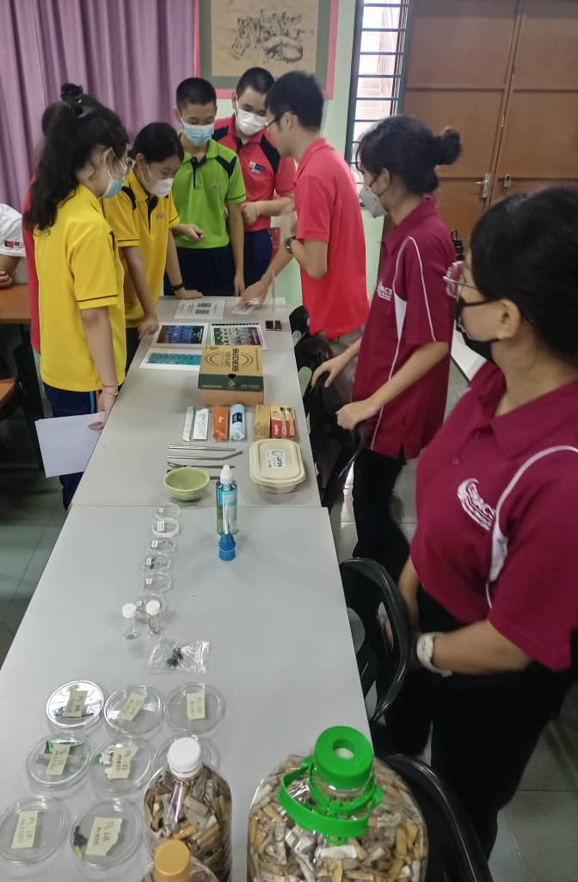
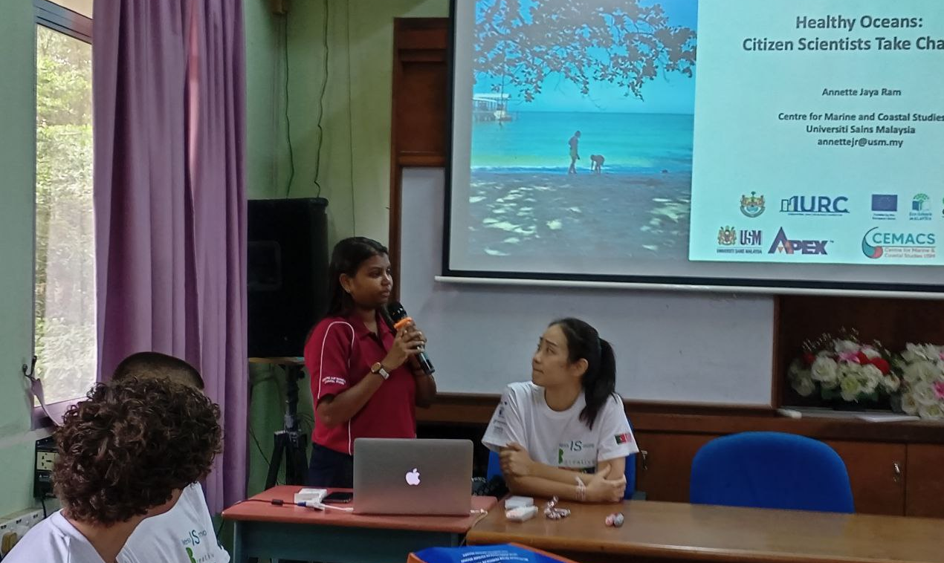
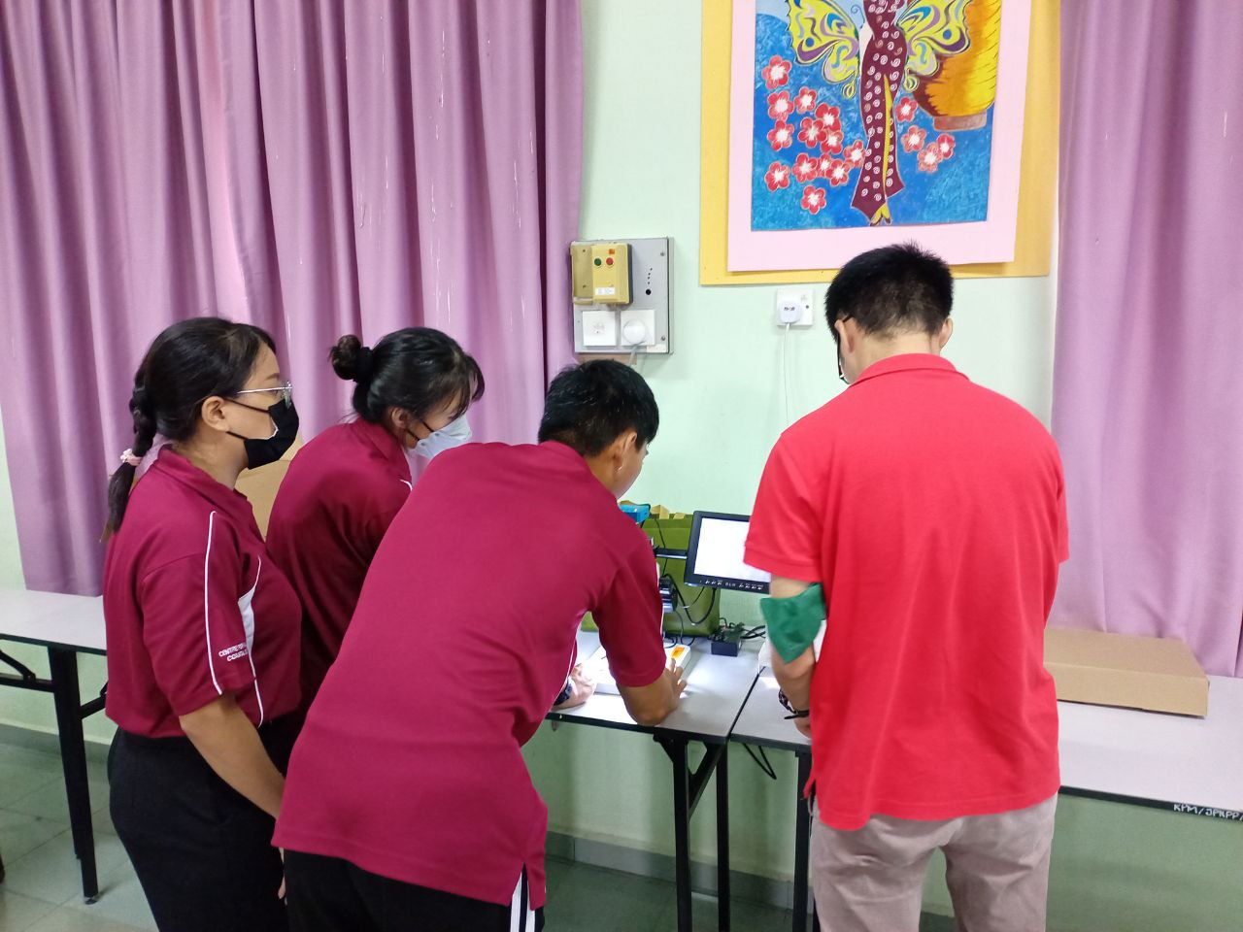
MARINE LITTER
environmental pollution
understand how terrible and detrimental the existence of plastic pollution
greatly threatening and affecting our life

Slide 4
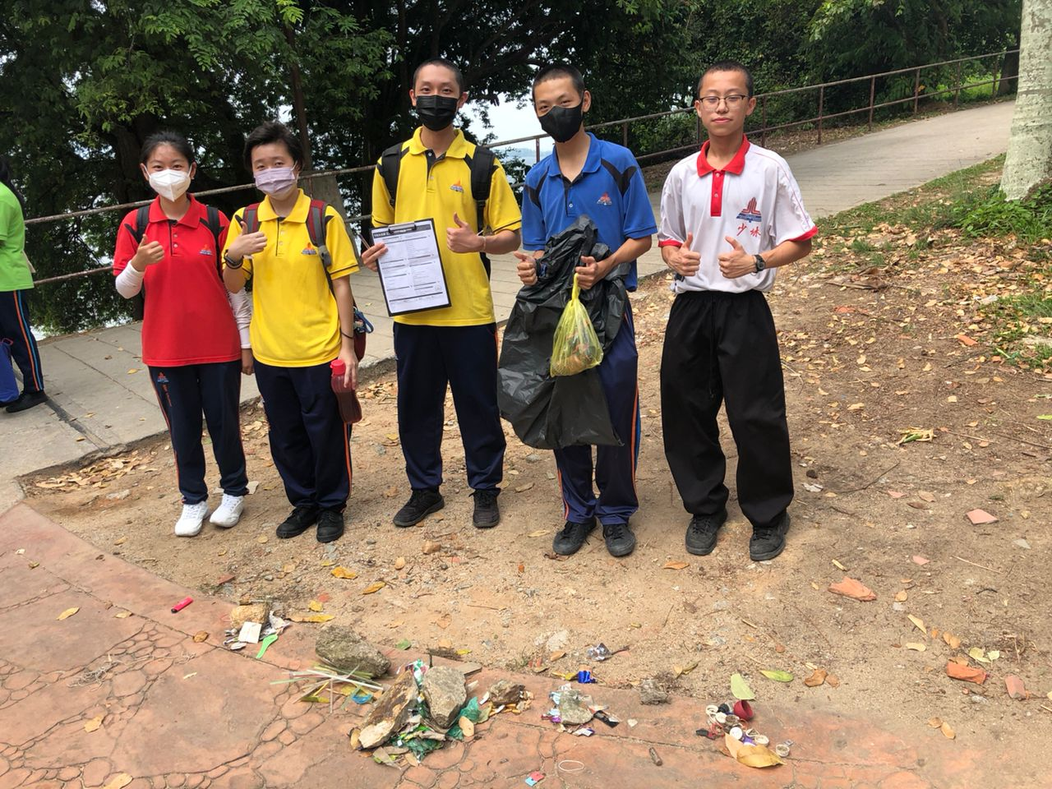
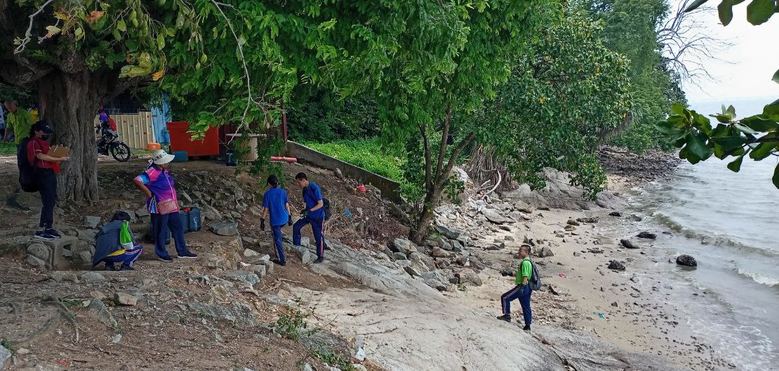
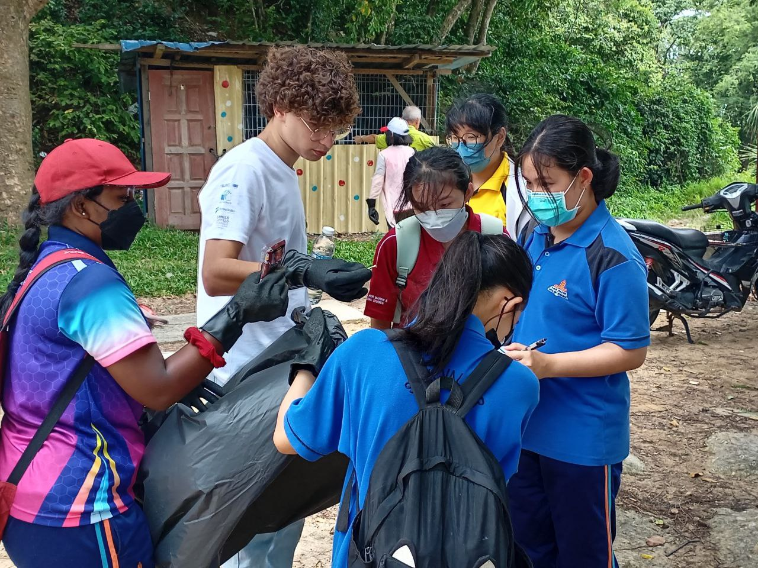
BEACH CLEAN UP
knowledge about the details and figures of different types of plastic wastes
take good care of our environment (marine)
strenghten the awareness of recycling
build the spirit of team work

Slide 5
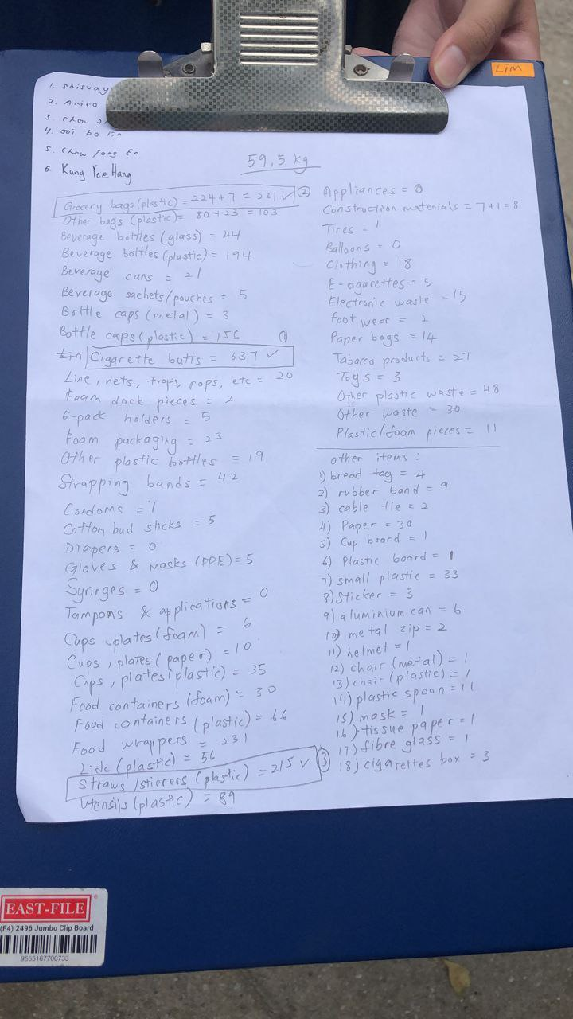
TOTAL COLLECTION:
59.5KG
DURATION:
1 HOUR
NUMBER OF PARTICIPANTS:
7 TEAMS
(34 STUDENTS)
TOP 3 TRASH
1. CIGARETTE BUTTS: 637
2. GROCERY BAGS: 231
3. STRAWS: 215

Slide 6
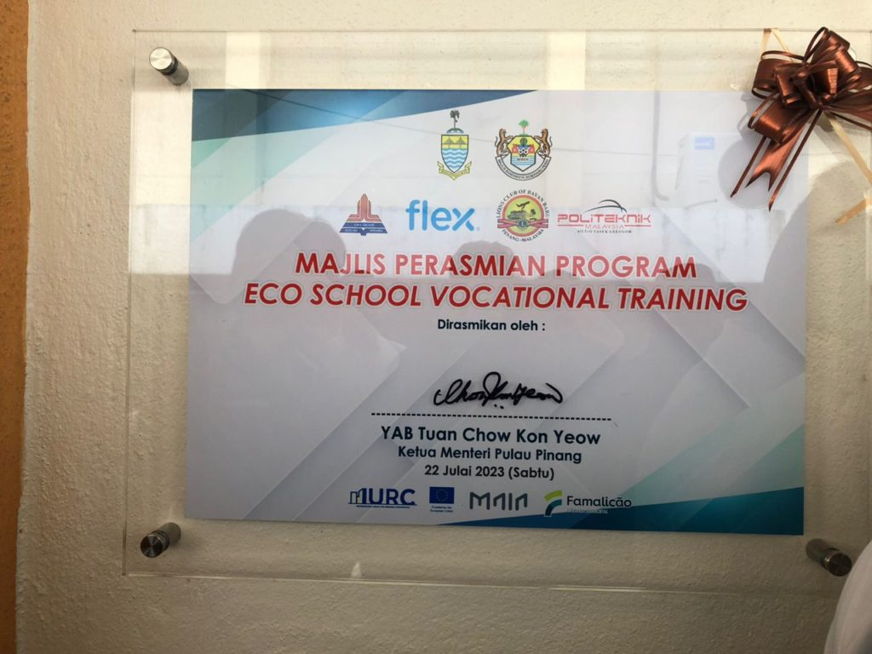
ECO VOCATIONAL TRAINING
E-waste
threat to the environment
encourage vocational training at eco-schools
collecting old and discarded computers & laptops
supporting partners
Lions Club Bayan Baru, Penang
Flextronics (Penang)- Eco Community Programme
Politeknik Malaysia Metro Tasek Gelugor

Slide 7
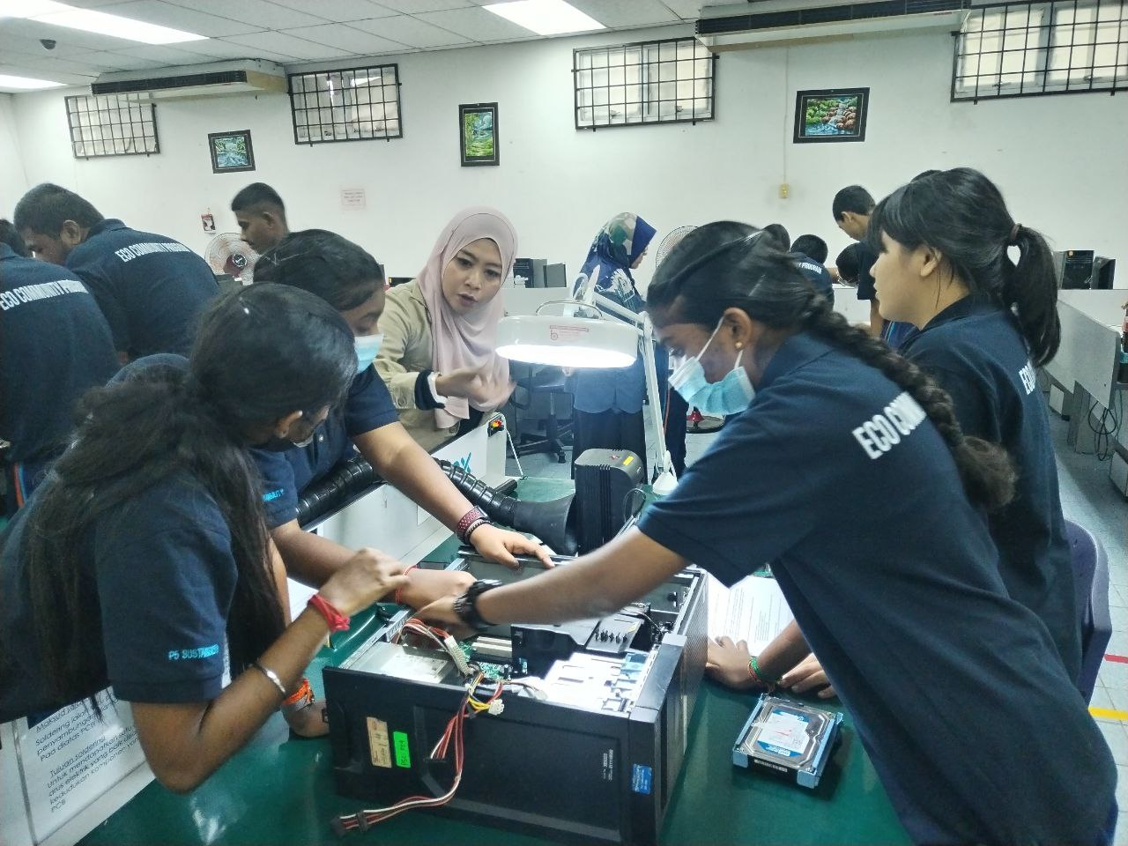
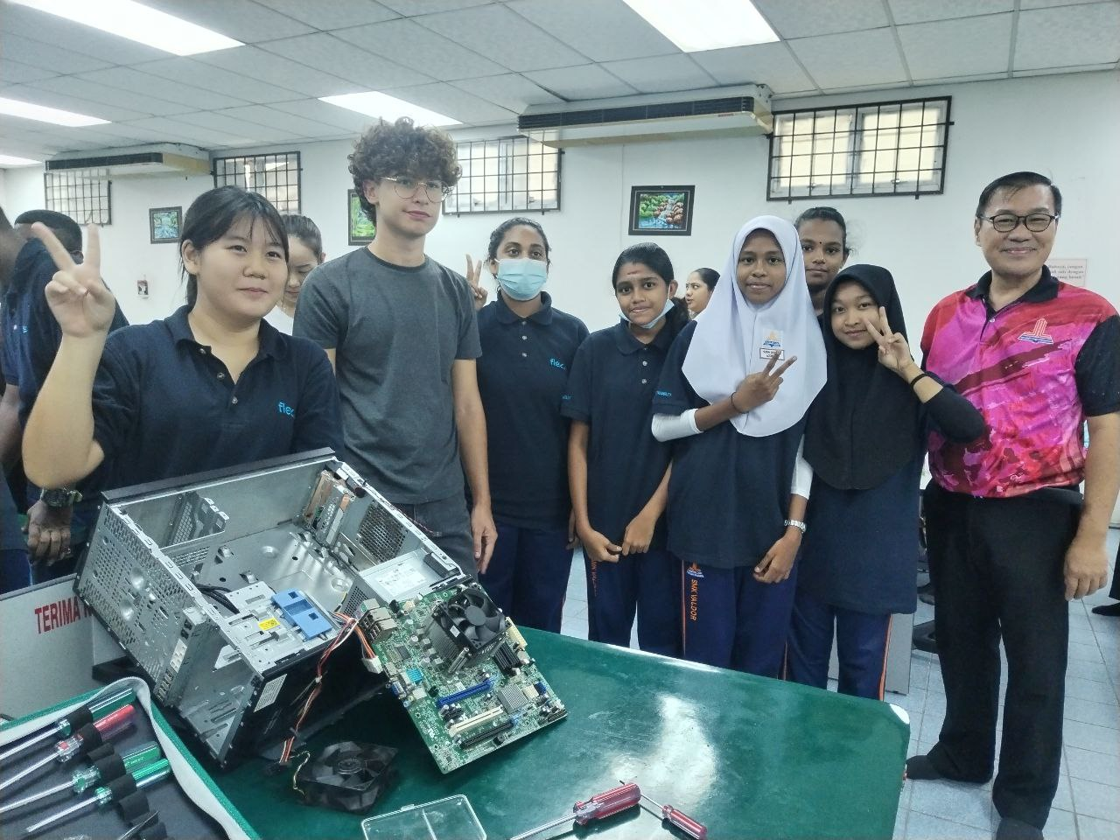
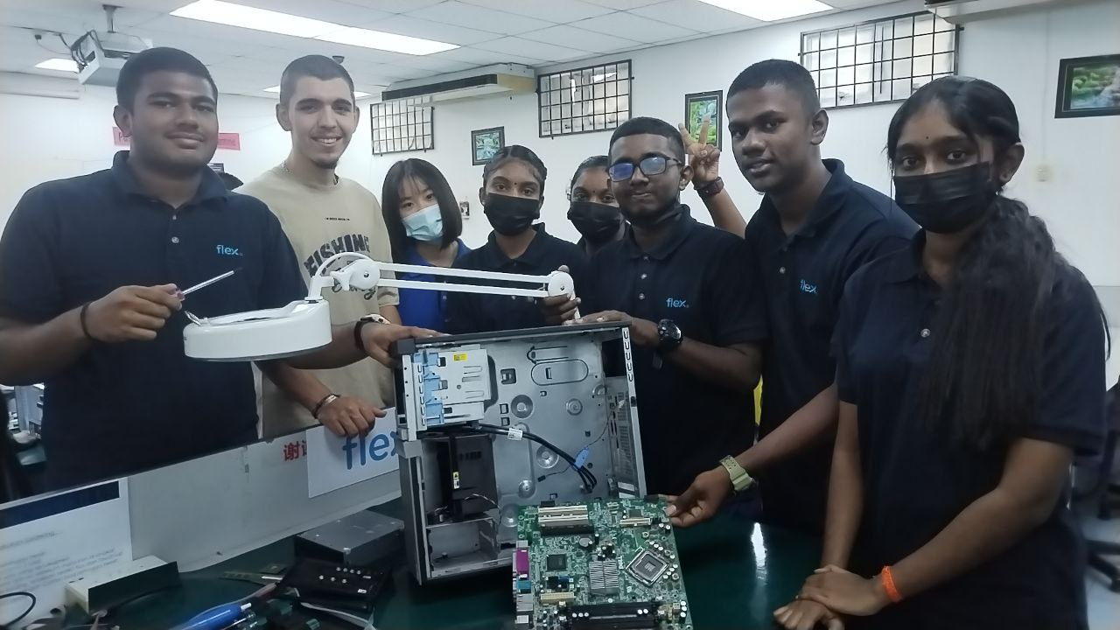
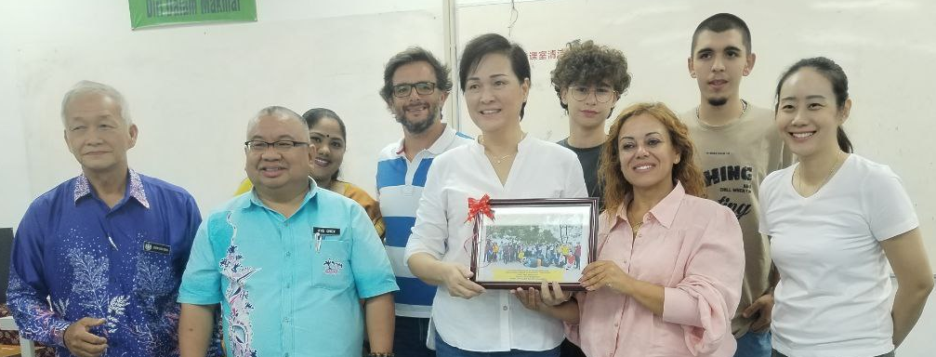
to train, equip and inculcate valuable skills among the students
understanding and applying the concept of closing the loop on e-waste

Slide 8
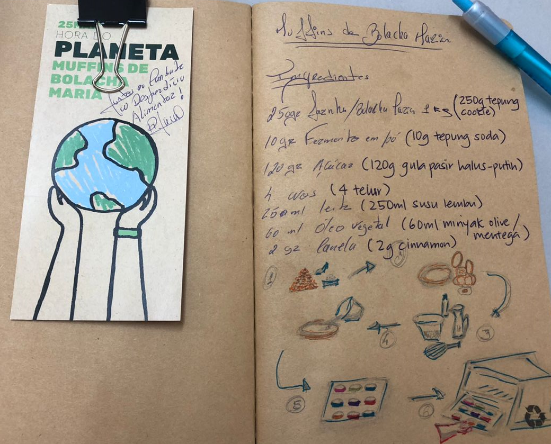
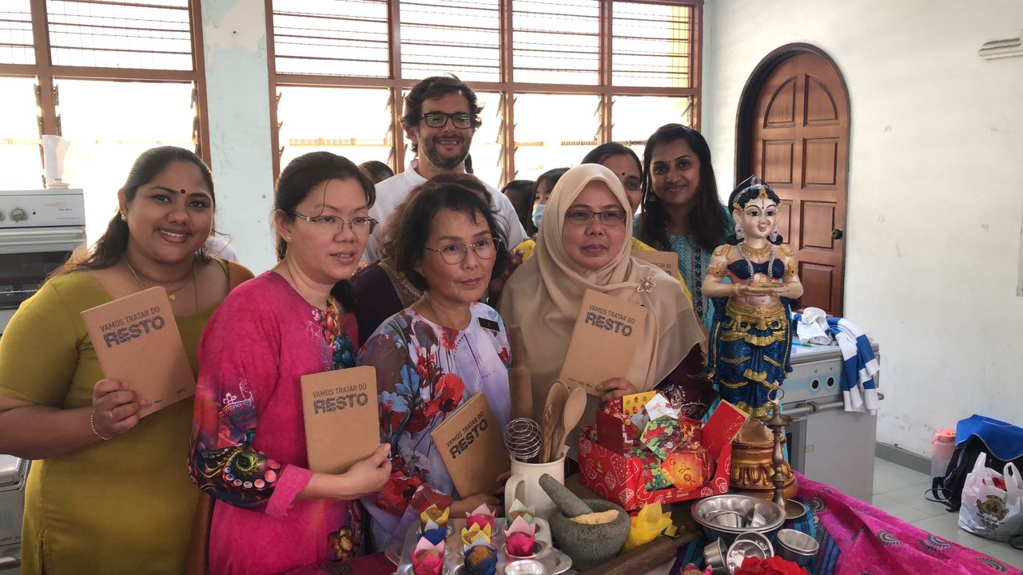
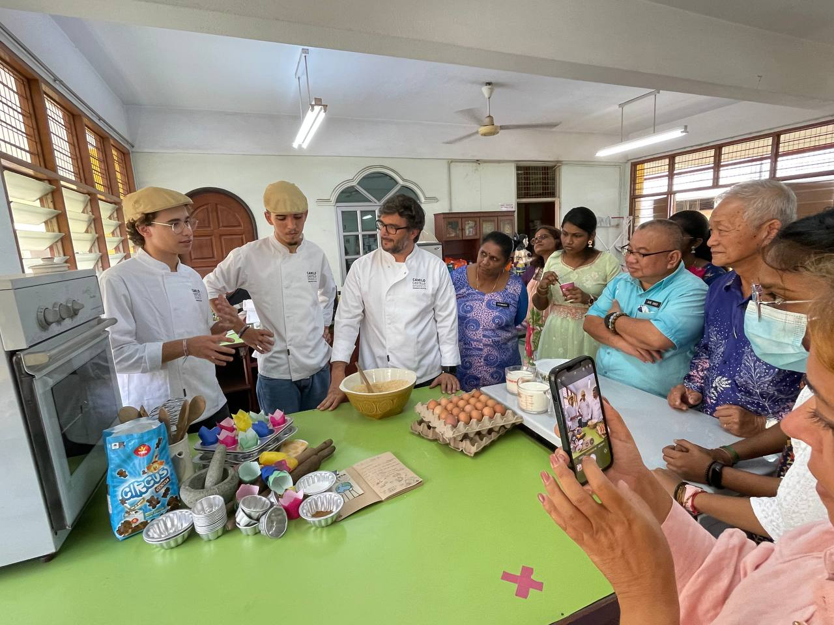
MARIA MUFFINS.....YUMMY!
food waste
creativity in cooking
cookie leftover into cookie flour
implementing it into our local dishes

Slide 9
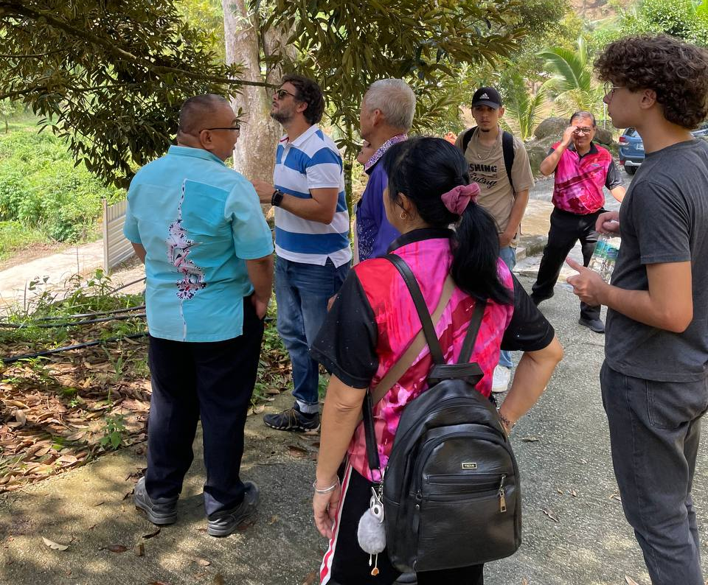
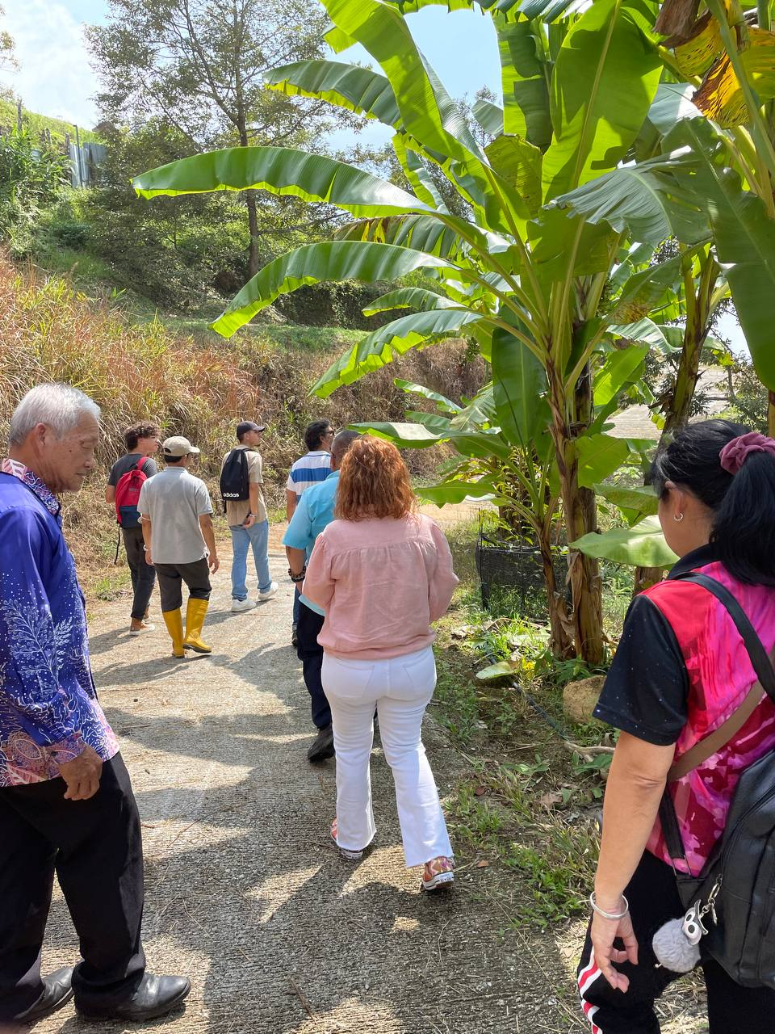
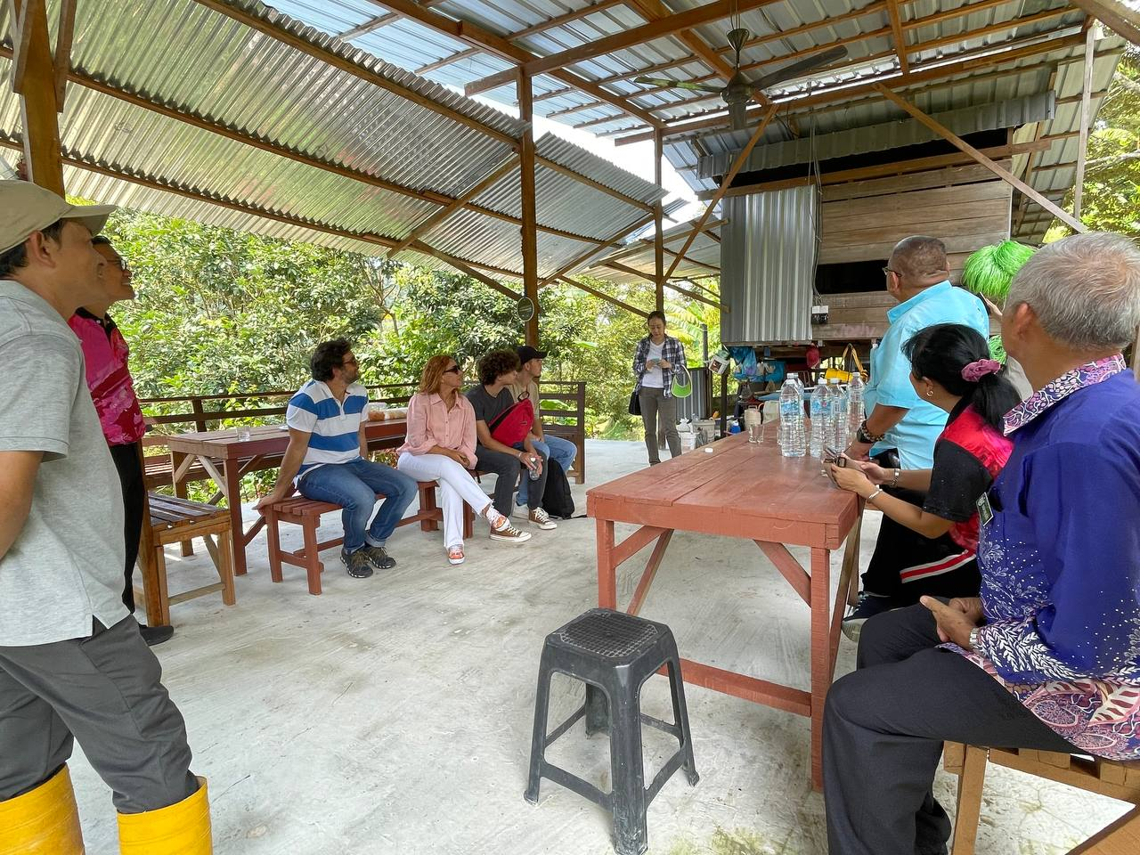
ORCHARD FARM VISIT
interesting visit- experience natural environment
learn about different types of fruit trees
rain water harvesting and powering electricity with roof top solar panels
taste local tropical fruits

Slide 10
LET’S THINK & ACT TOGETHER
ENVIRONMENT IS THE MOST ESSENTIAL PART IN OUR LIFE
BUILD UP SOME GOOD HABIT OF PROTECTING THE ENVIRONMENT
TAKE IMMEDIATE ACTION AND ENCOURAGE PUBLIC TO TAKE GOOD CARE OF THE ENVIRONMENT
OBTAIN BETTER QUALITY OF LIFE
UNITED AS A HUMAN RACE TO MAKE THE WORLD A BETTER PLACE

Slide 11
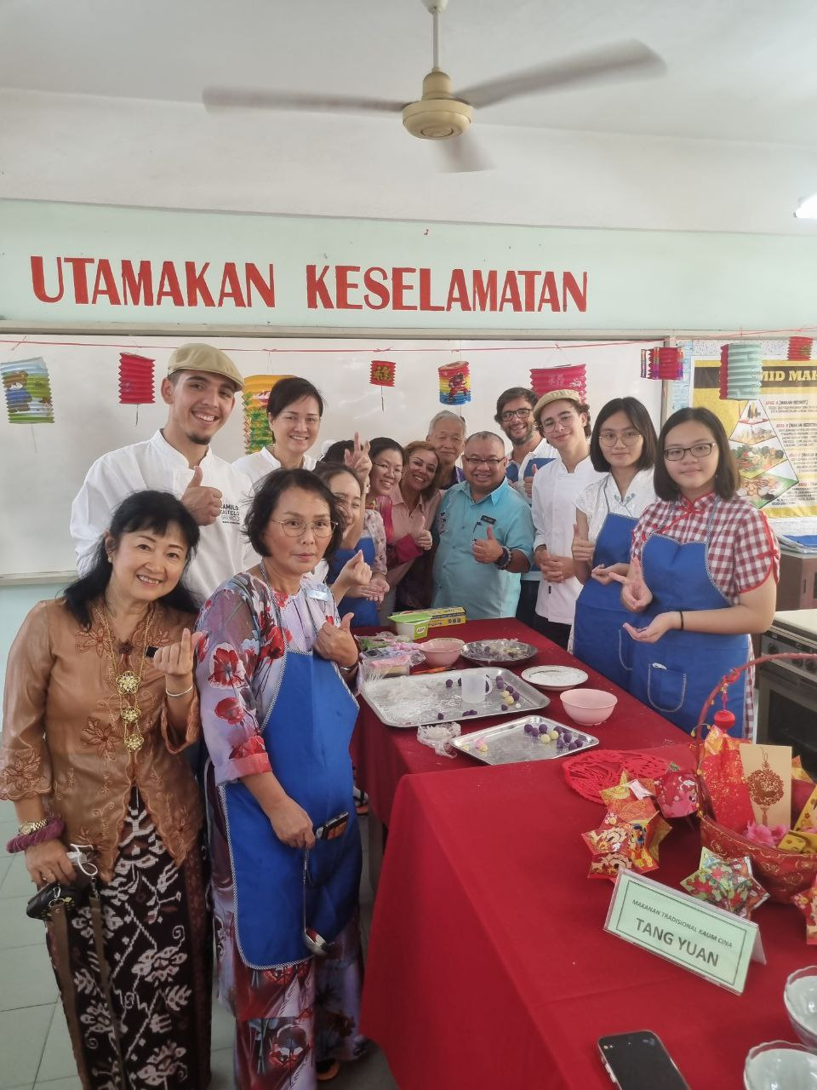
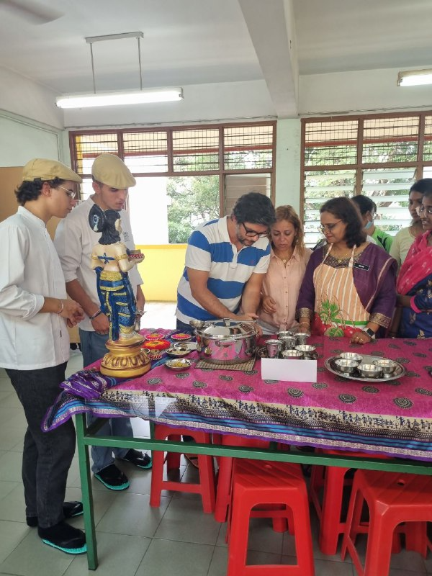
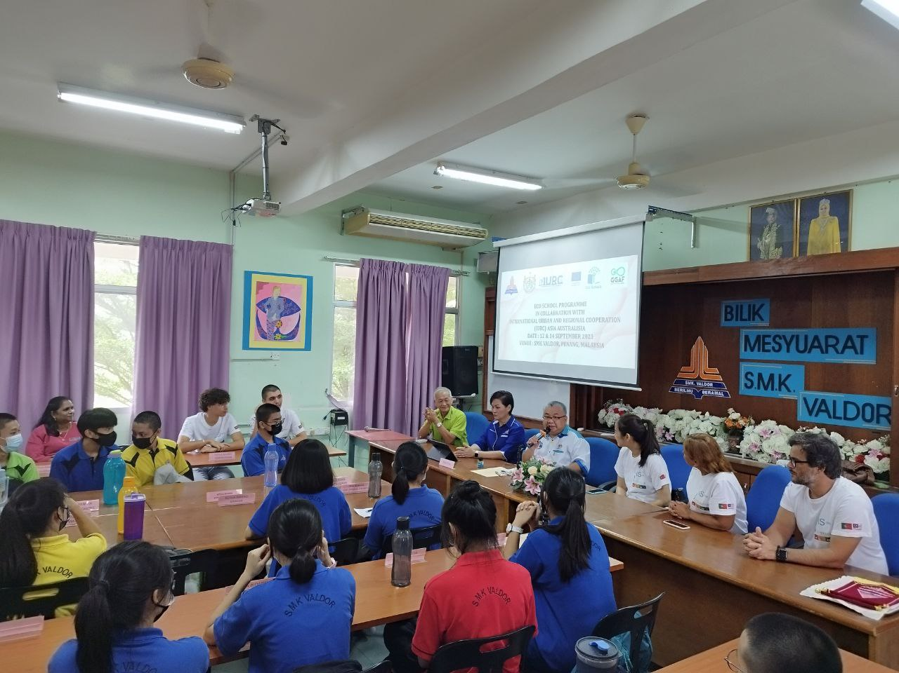
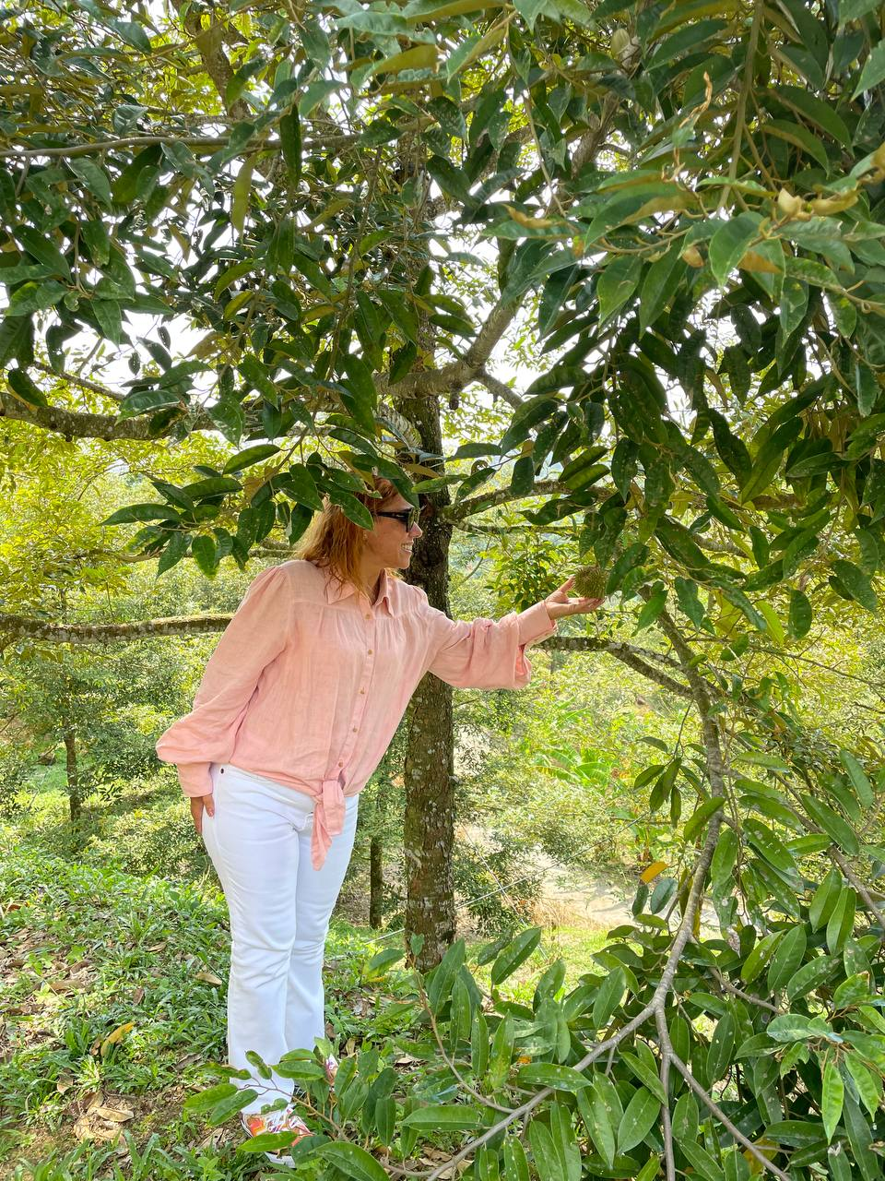
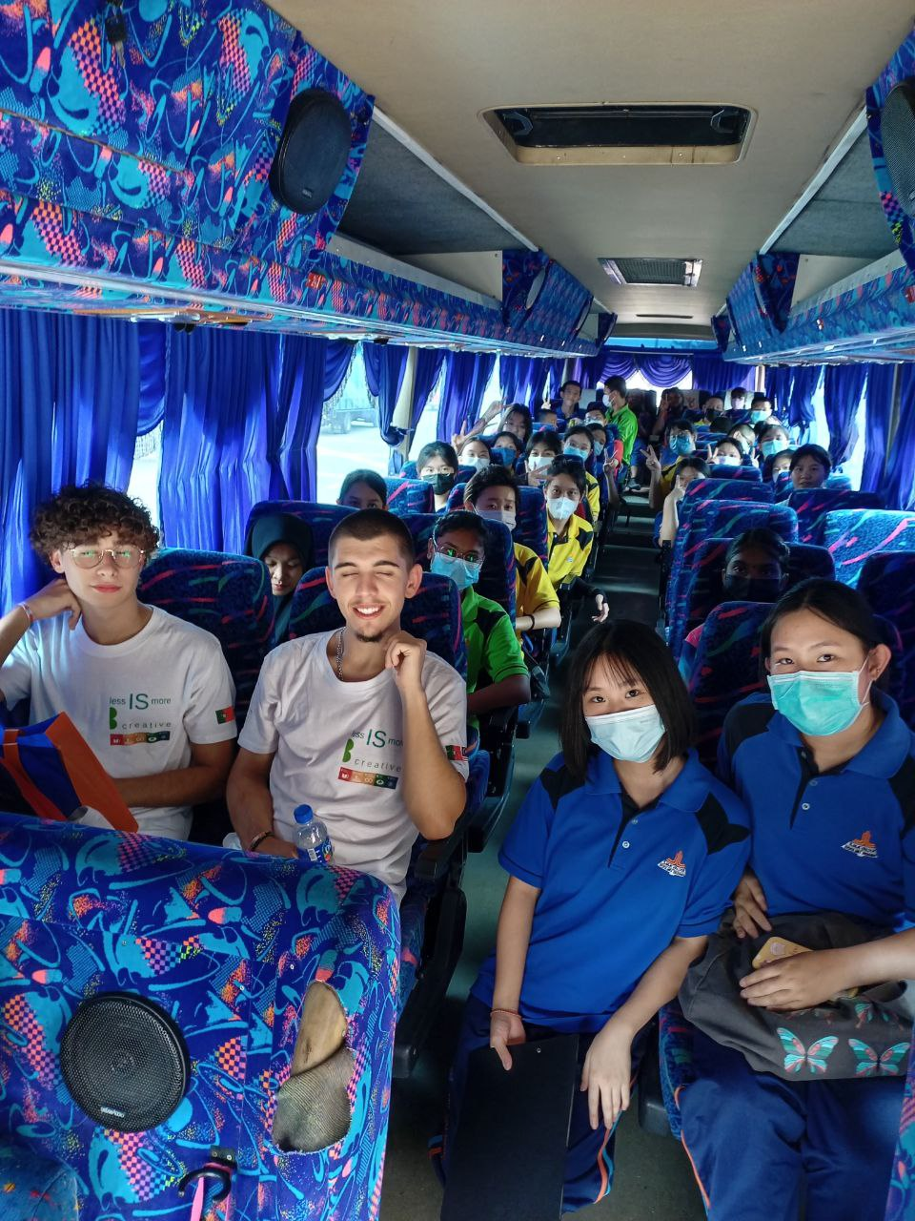
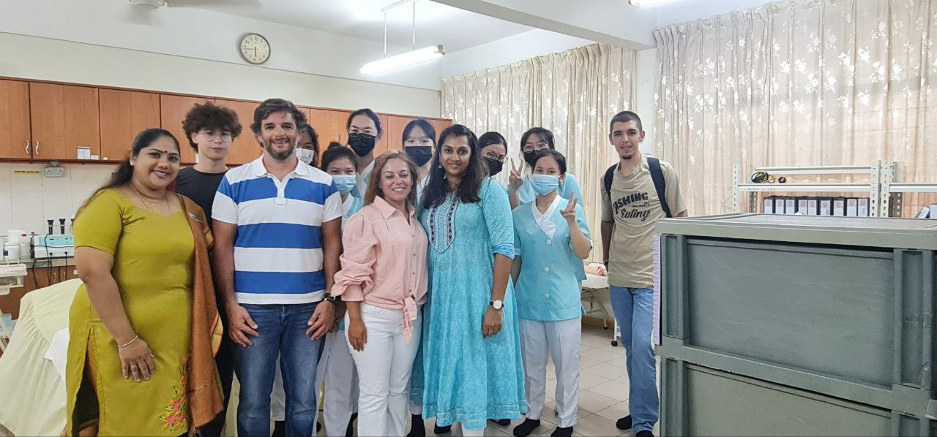
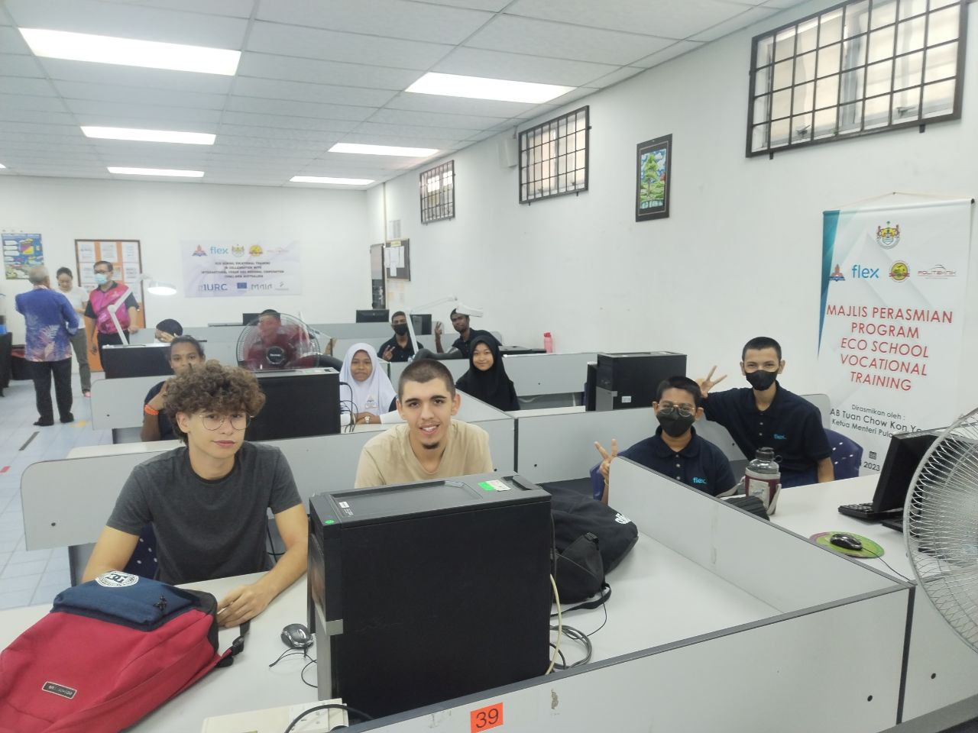
MEMORIES
OBRIGADO!

