Slide 1









ECO SCHOOL VOCATIONAL TRAINING
IN COLLABRATION WITH
INTERNATIONAL URBAN AND REGIONAL COOPERATION
(IURC) ASIA AUSTRALISIA

Slide 2
ECO SCHOOL VOCATIONAL TRAINING IN COLLABRATION WITH
INTERNATIONAL URBAN AND REGIONAL COOPERATION
(IURC) ASIA AUSTRALISIA
DAY 1 // The Impact of Marine Litter in our Oceans
Plastic waste is increasingly polluting the oceans and according to one estimation, by 2050 the oceans could contain more plastic than fish by weight.

Slide 3
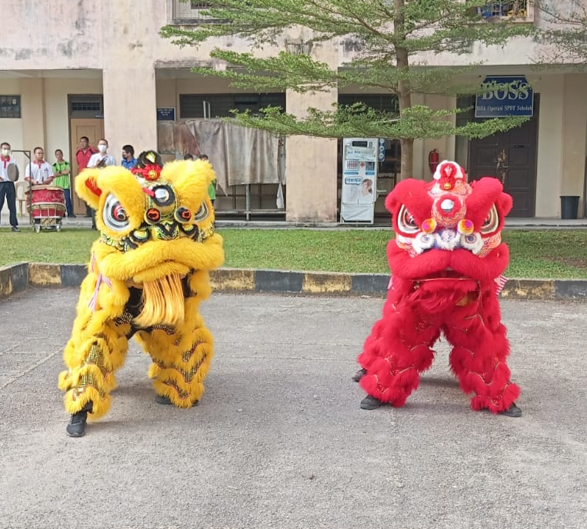
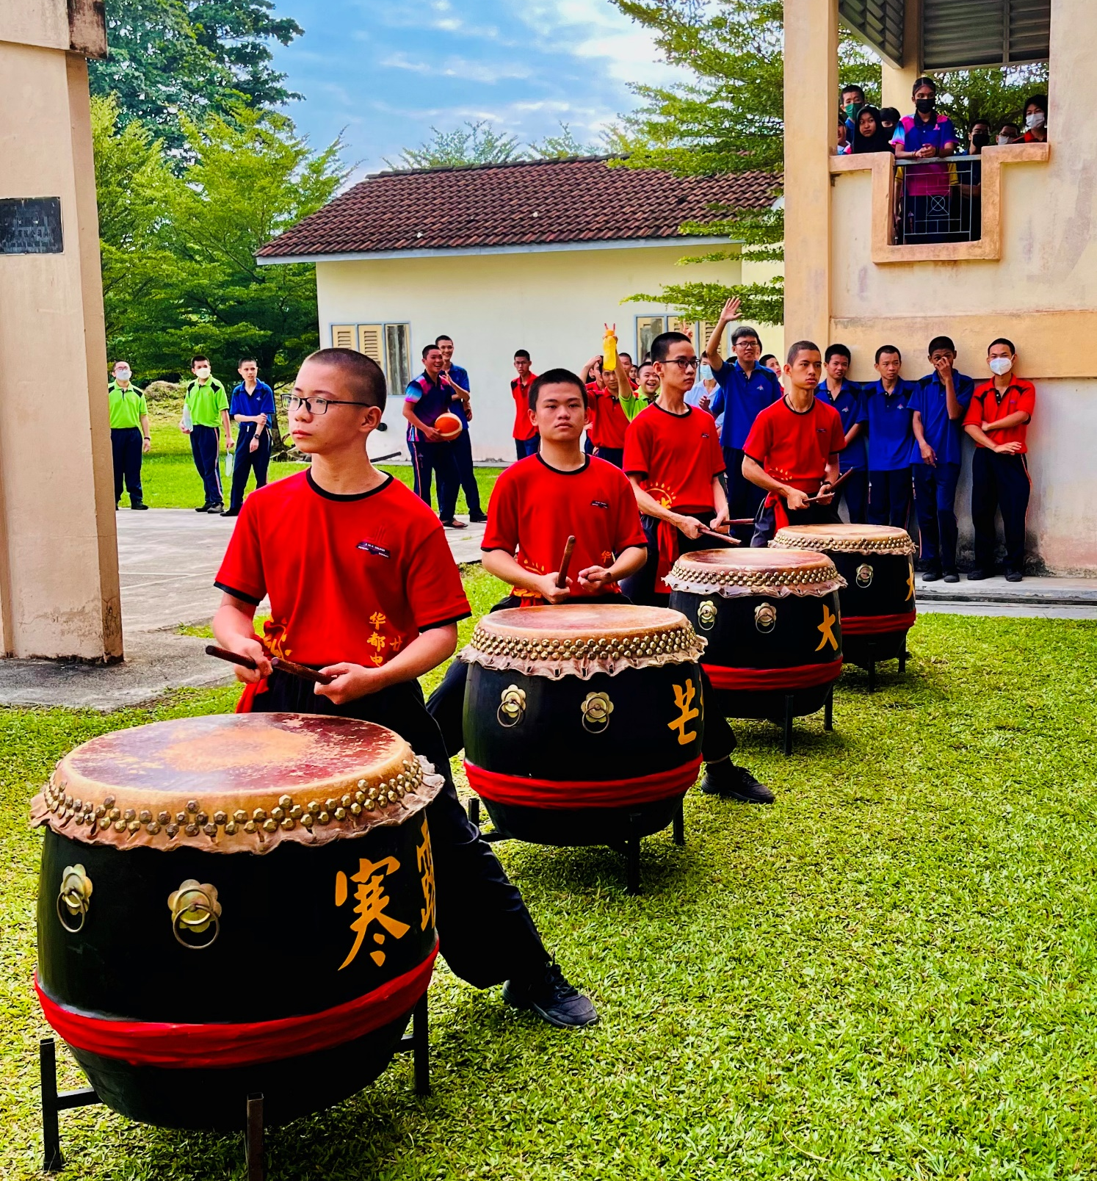
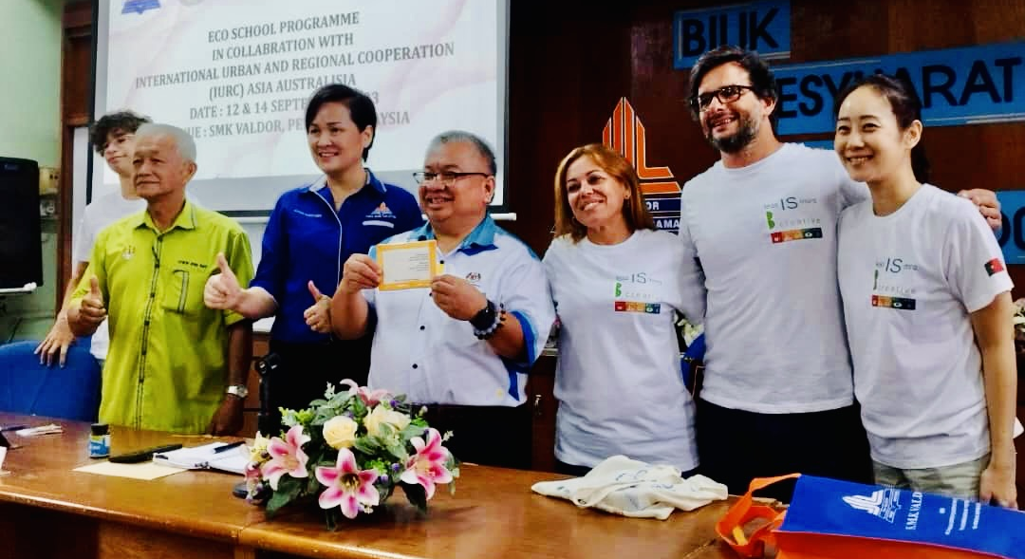
ECO SCHOOL VOCATIONAL TRAINING IN COLLABRATION WITH
INTERNATIONAL URBAN AND REGIONAL COOPERATION
(IURC) ASIA AUSTRALISIA
DAY 1 // The Impact of Marine Litter in our Oceans

Slide 4
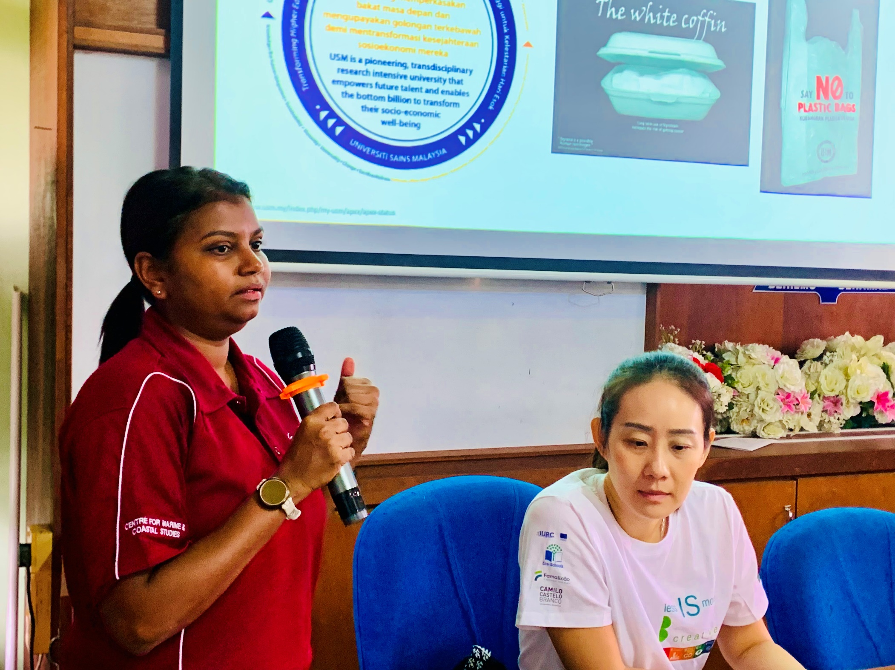
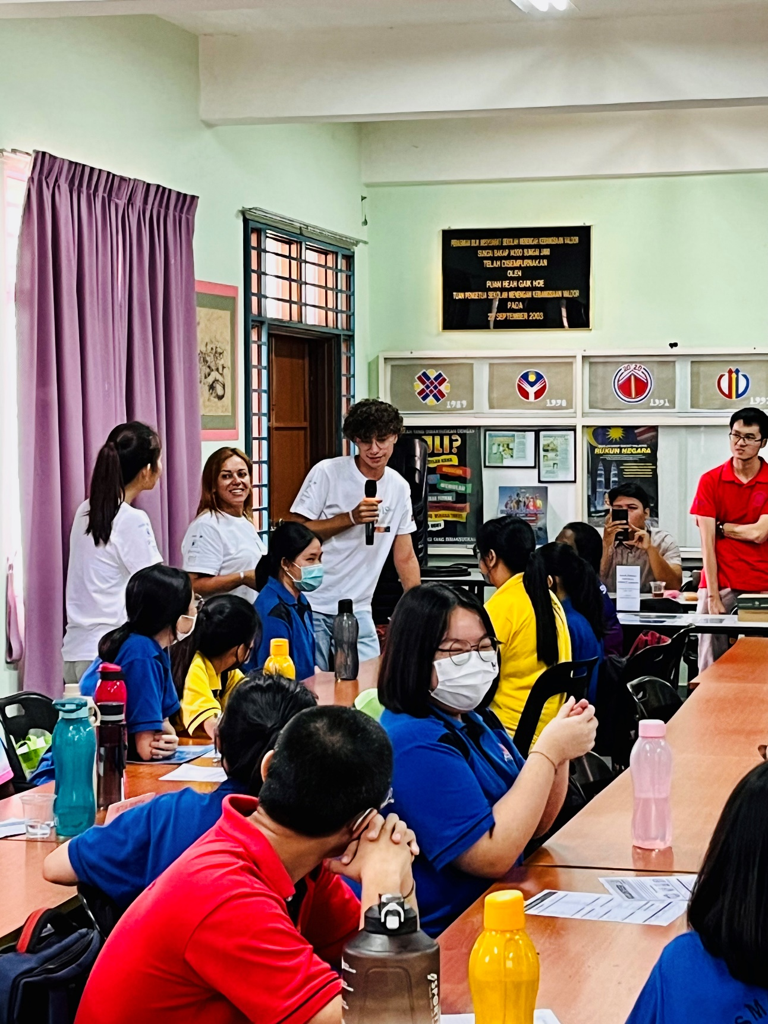
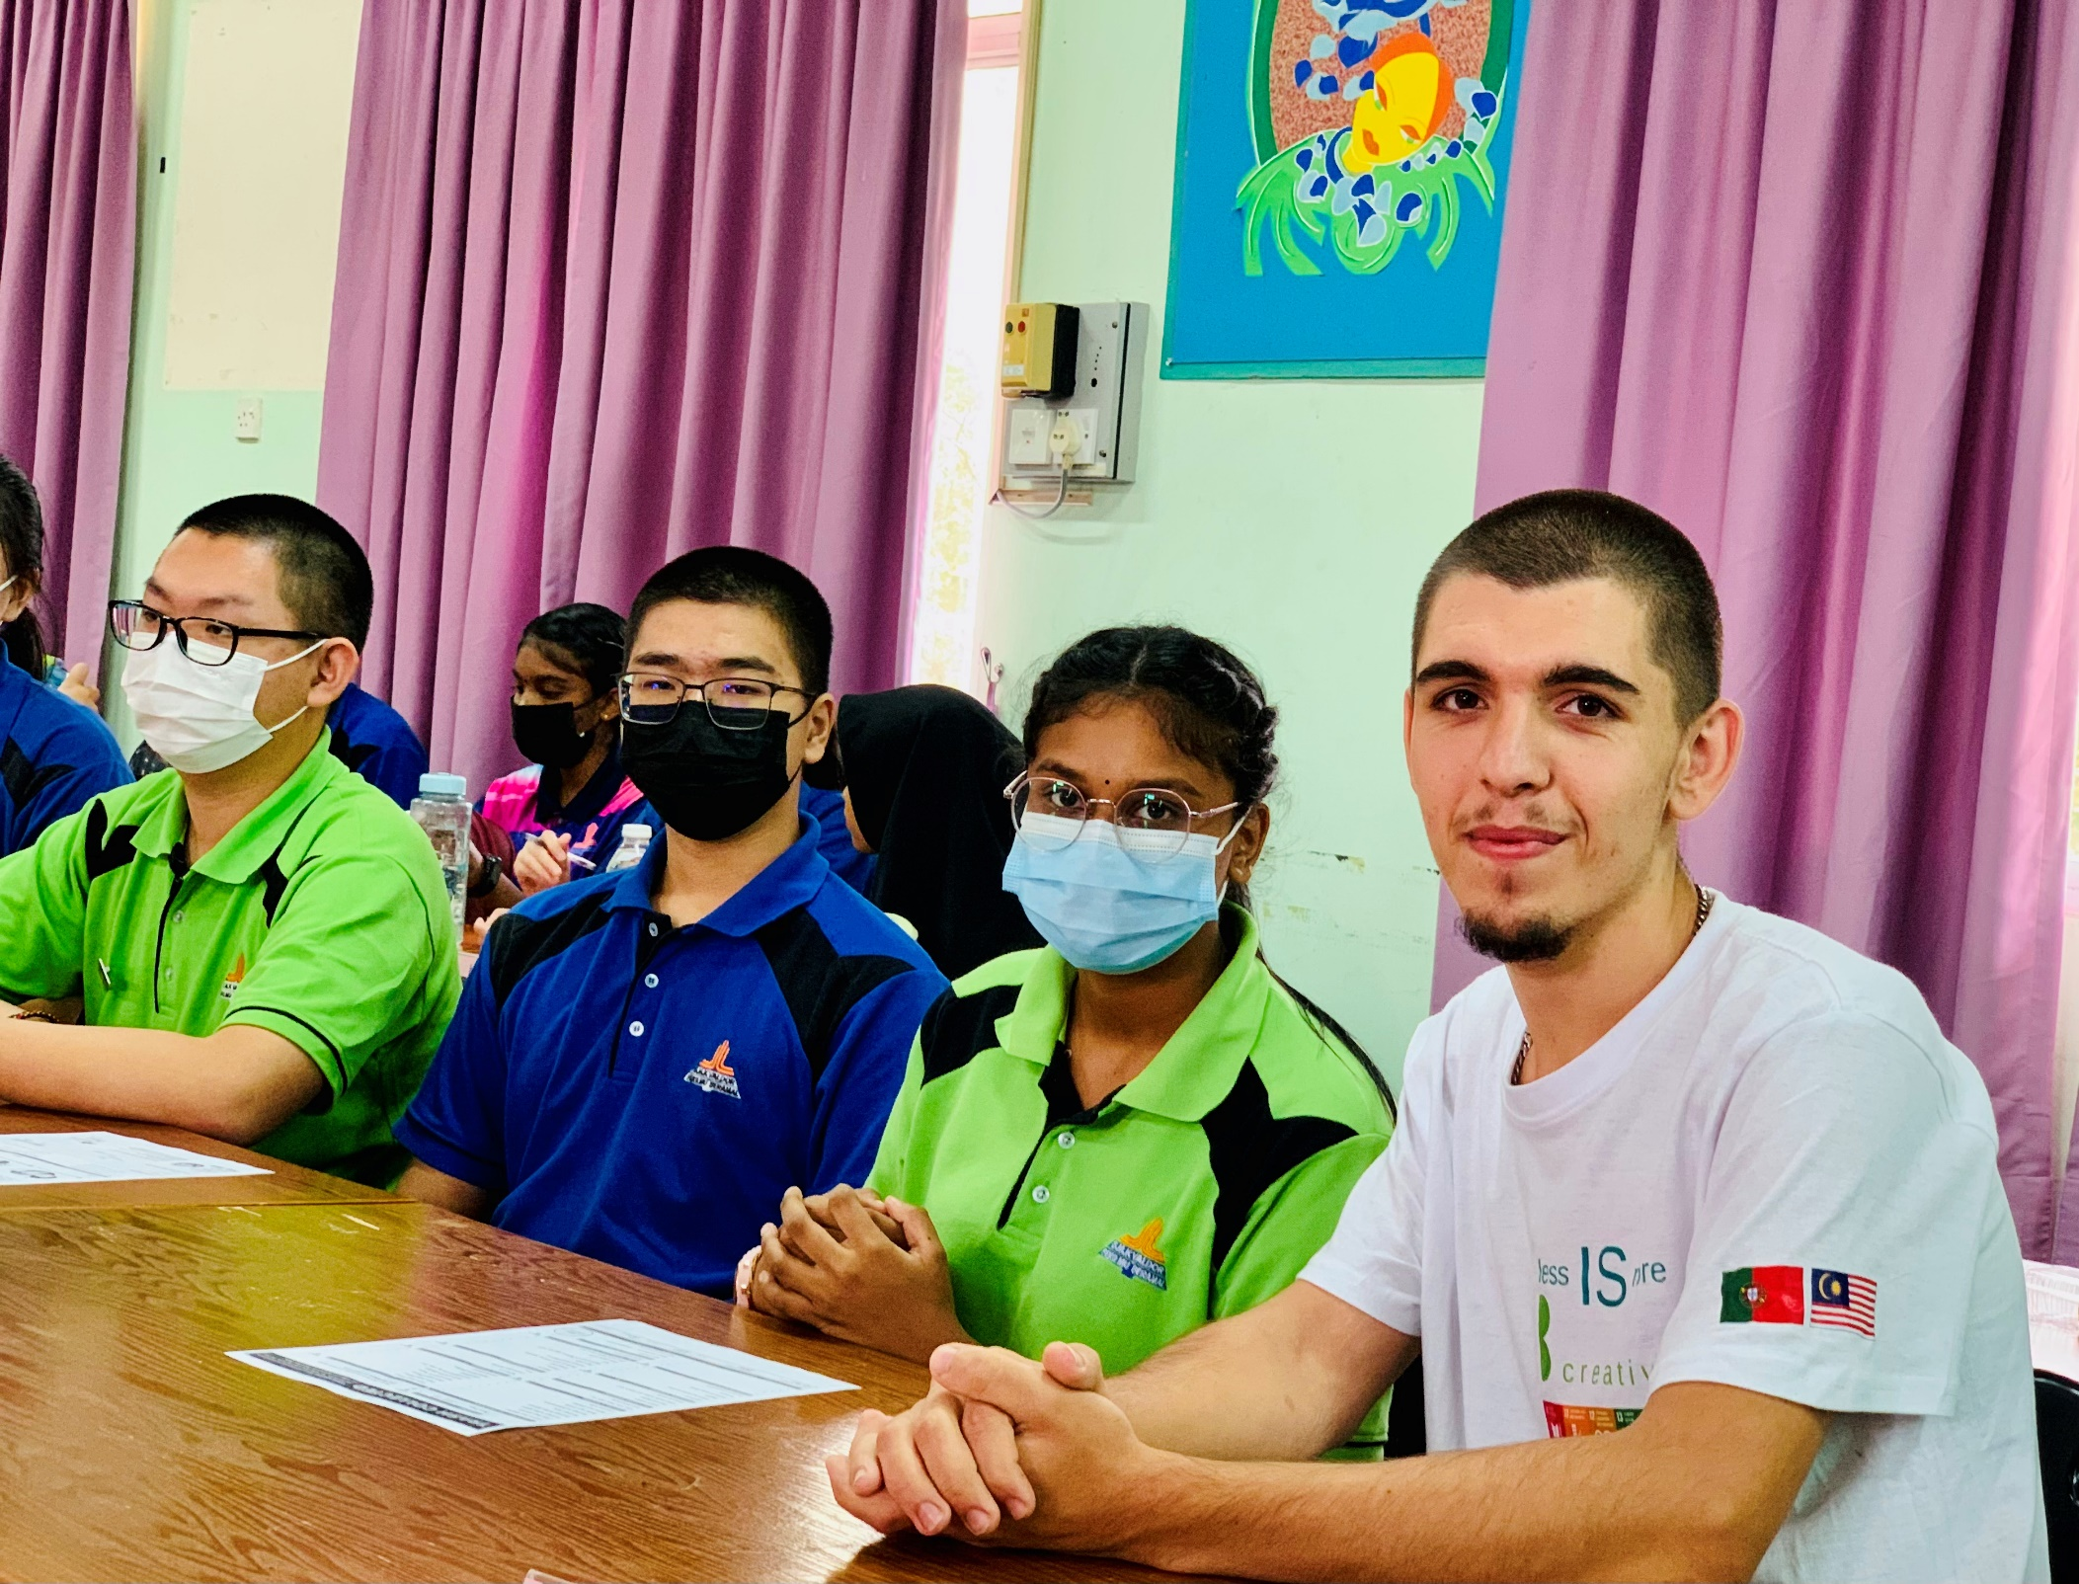
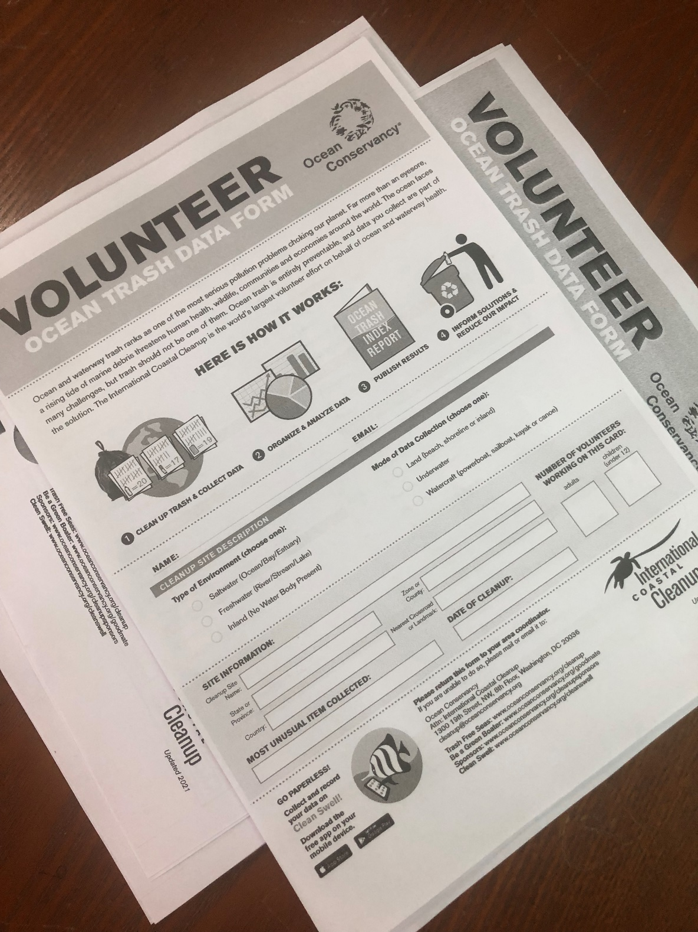
ECO SCHOOL VOCATIONAL TRAINING IN COLLABRATION WITH
INTERNATIONAL URBAN AND REGIONAL COOPERATION
(IURC) ASIA AUSTRALISIA
DAY 1 // The Impact of Marine Litter in our Oceans

Slide 5
ECO SCHOOL VOCATIONAL TRAINING IN COLLABRATION WITH
INTERNATIONAL URBAN AND REGIONAL COOPERATION
(IURC) ASIA AUSTRALISIA
DAY 1 // The Impact of Marine Litter in our Oceans
Problems caused by plastic wasted in the ocean to:
Marine life
Human health
Economy
Climate

Slide 6
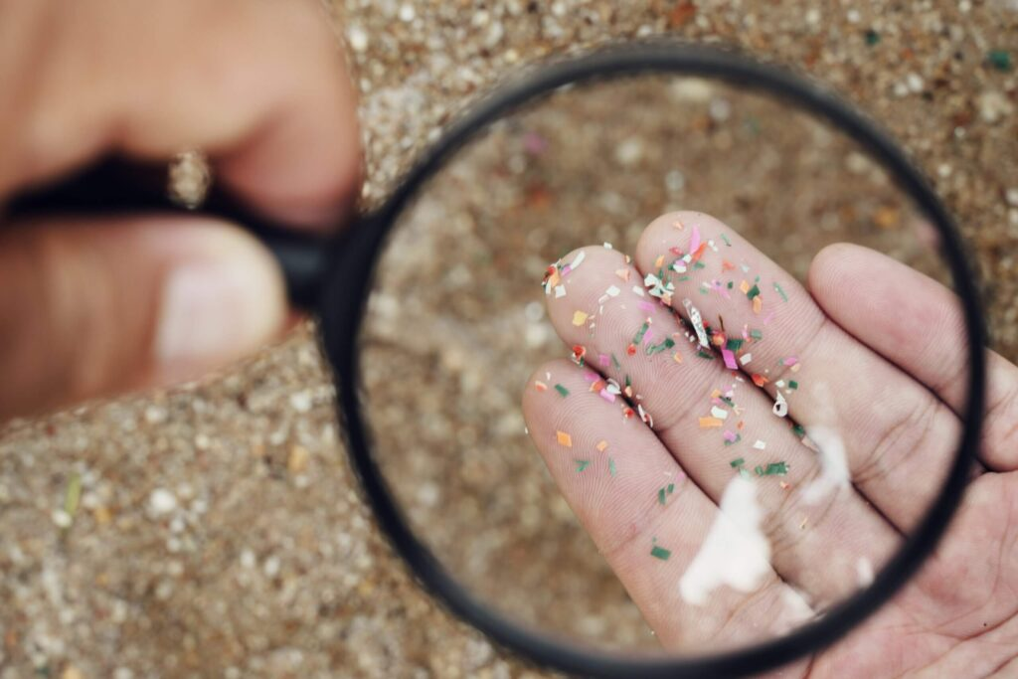
ECO SCHOOL VOCATIONAL TRAINING IN COLLABRATION WITH
INTERNATIONAL URBAN AND REGIONAL COOPERATION
(IURC) ASIA AUSTRALISIA
DAY 1 // The Impact of Marine Litter in our Oceans
A huge amount of tiny plastic particles is currently drifting in the ocean. They are potentially life-threatening for marine life. Once in the ocean, microplastics can no longer be removed. Therefore, it is crucial to prevent them from entering the ocean in the first place.

Slide 7
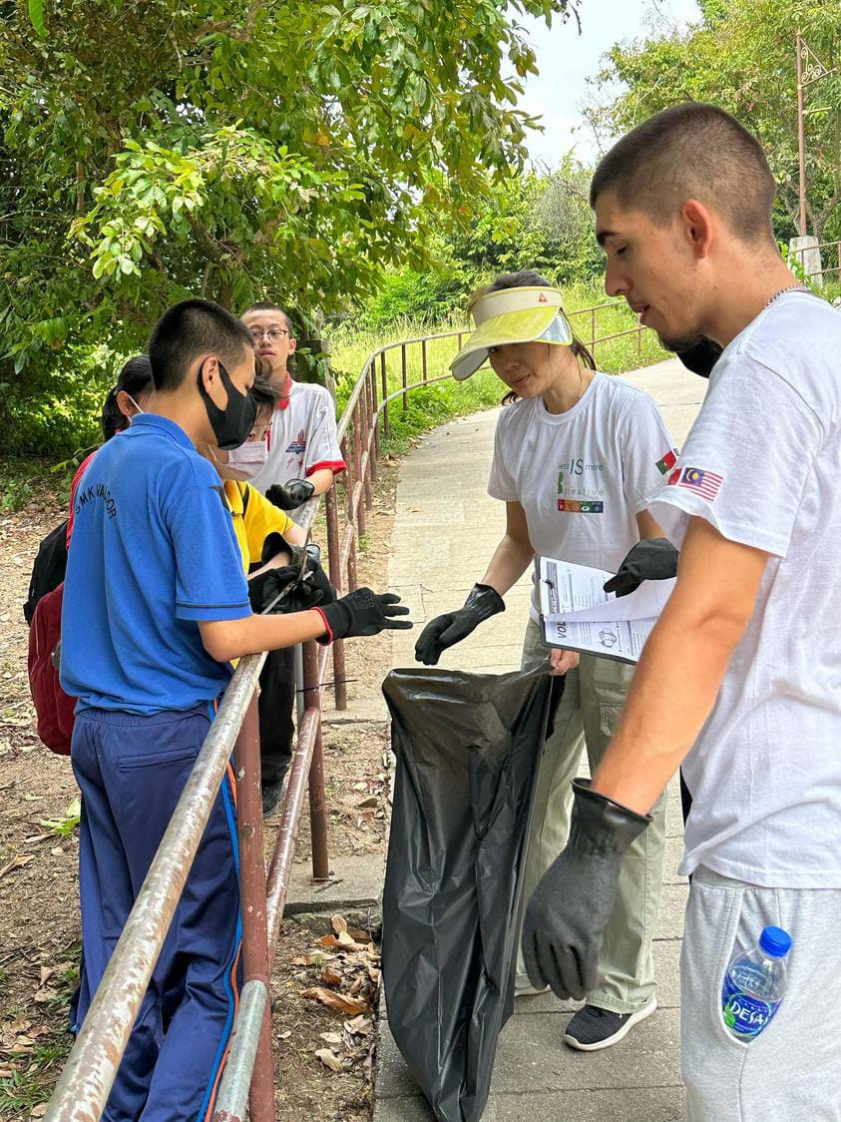
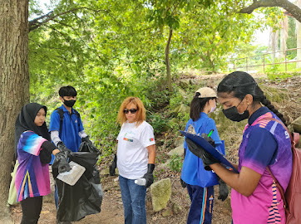
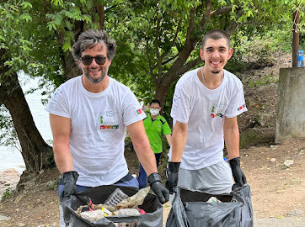
ECO SCHOOL VOCATIONAL TRAINING IN COLLABRATION WITH
INTERNATIONAL URBAN AND REGIONAL COOPERATION
(IURC) ASIA AUSTRALISIA
DAY 1 // The Impact of Marine Litter in our Oceans

Slide 8
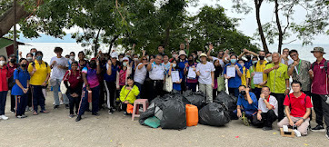
ECO SCHOOL VOCATIONAL TRAINING IN COLLABRATION WITH
INTERNATIONAL URBAN AND REGIONAL COOPERATION
(IURC) ASIA AUSTRALISIA
DAY 1 // The Impact of Marine Litter in our Oceans

Slide 9
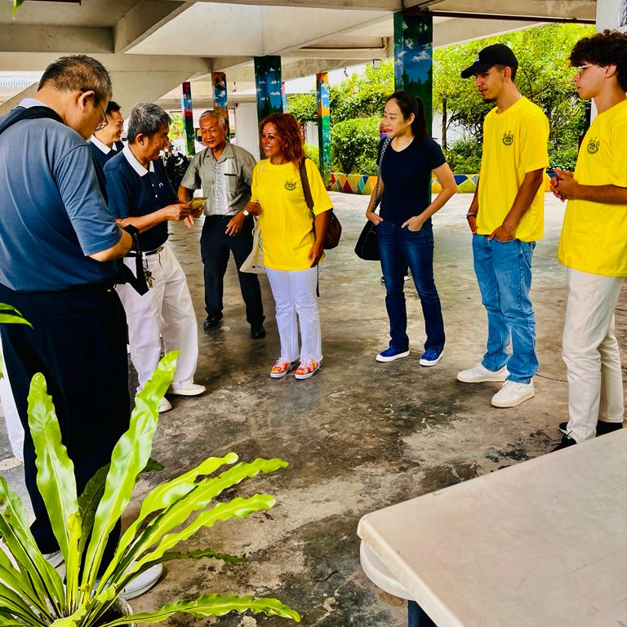
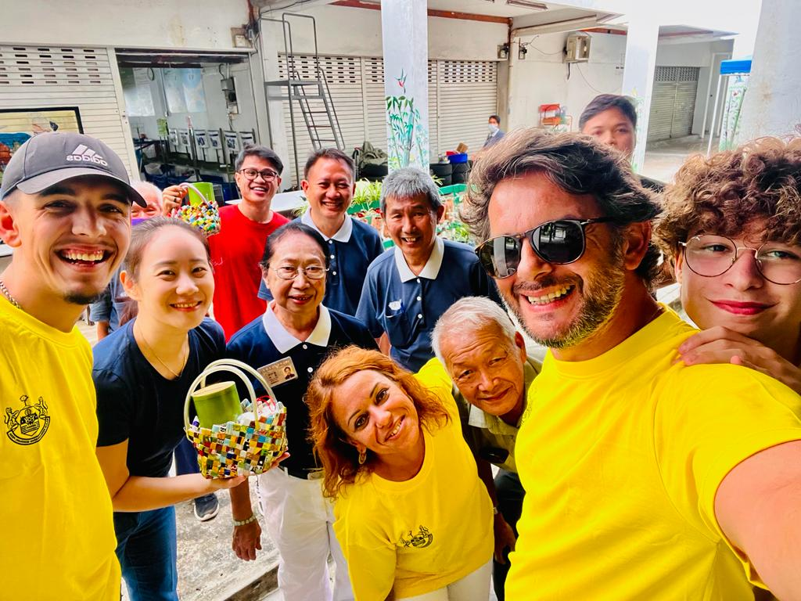
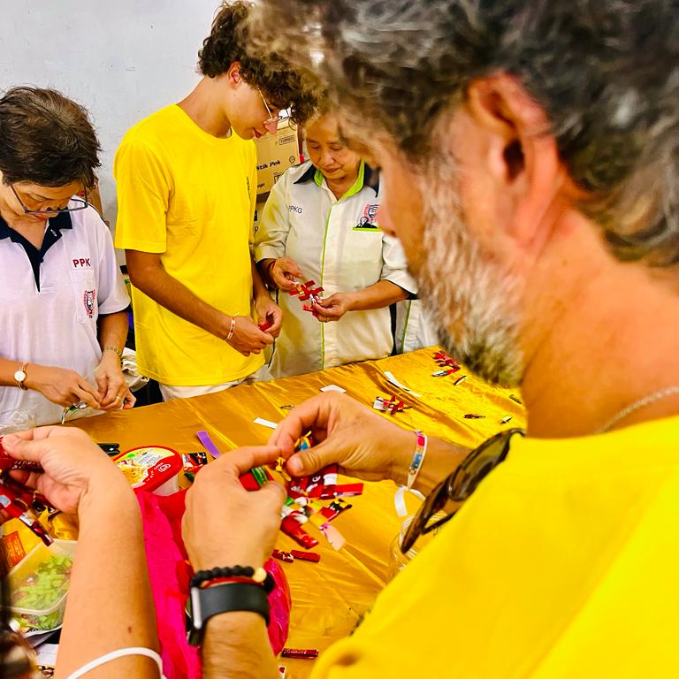
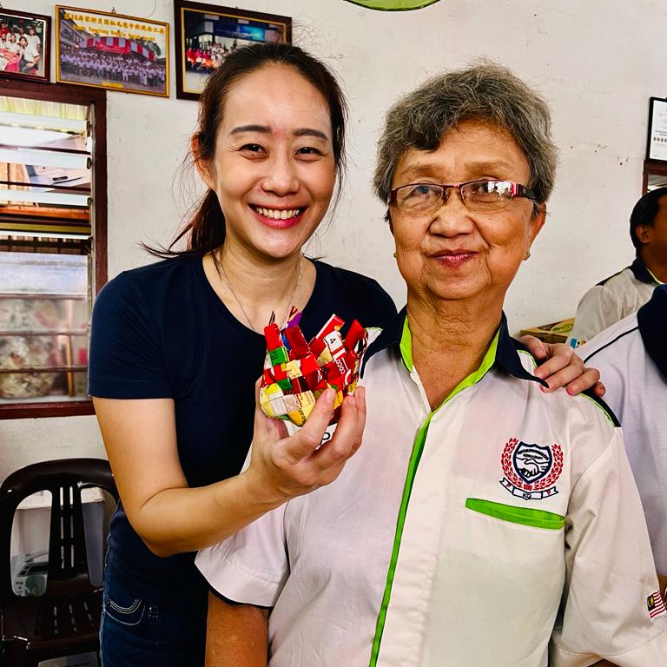
ECO SCHOOL VOCATIONAL TRAINING IN COLLABRATION WITH
INTERNATIONAL URBAN AND REGIONAL COOPERATION
(IURC) ASIA AUSTRALISIA
DAY 2 // Upcycling Hard to Recycle Plastics and Old Newspaper from Bottom 40 (B40) community groups

Slide 10
ECO SCHOOL VOCATIONAL TRAINING IN COLLABRATION WITH
INTERNATIONAL URBAN AND REGIONAL COOPERATION
(IURC) ASIA AUSTRALISIA
DAY 2 // Upcycling Hard to Recycle Plastics and Old Newspaper from Bottom 40 (B40) community groups
High pollution levels, environmental degradation and the depletion of natural resources.
Fighting plastic pollution
Moving towards more recycling and less plastic waste

Slide 11
ECO SCHOOL VOCATIONAL TRAINING IN COLLABRATION WITH
INTERNATIONAL URBAN AND REGIONAL COOPERATION
(IURC) ASIA AUSTRALISIA
We need to:
prevent and reduce the impact of certain plastic products on the environment, in particular the marine environment, and on human health
promote the transition to a circular economy with innovative and sustainable business models, products and materials.

Slide 12
ECO SCHOOL VOCATIONAL TRAINING IN COLLABRATION WITH
INTERNATIONAL URBAN AND REGIONAL COOPERATION
(IURC) ASIA AUSTRALISIA
Young people claims a plastic strategy for a circular economy!
We need to transform the way plastic products are designed, produced, used and recycled.

Slide 13
ECO SCHOOL VOCATIONAL TRAINING IN COLLABRATION WITH
INTERNATIONAL URBAN AND REGIONAL COOPERATION
(IURC) ASIA AUSTRALISIA
DAY 3 // Reducing food waste with local and traditional recipes
We all need to eat, but today’s food systems are failing.
How we produce and consume food is the biggest driver of nature loss and a major cause of greenhouse gas emissions.
Huge amount of the food we produce is going uneaten - a waste of natural resources, human labour and money.

Slide 14
ECO SCHOOL VOCATIONAL TRAINING IN COLLABRATION WITH
INTERNATIONAL URBAN AND REGIONAL COOPERATION
(IURC) ASIA AUSTRALISIA
DAY 3 // Reducing food waste with local and traditional recipes
It’s clear our food systems need to change – urgently – to work with the planet, not against it.
Roughly 1/3 of the food produced in the world for human consumption is lost or wasted.
Food waste alone generates about 8% - 10% of global greenhouse gas emissions.
If food waste were a country, it would be the third largest emitting country in the world. In other words: food waste emits more greenhouse gases than all single countries in the world except China and the US.

Slide 15
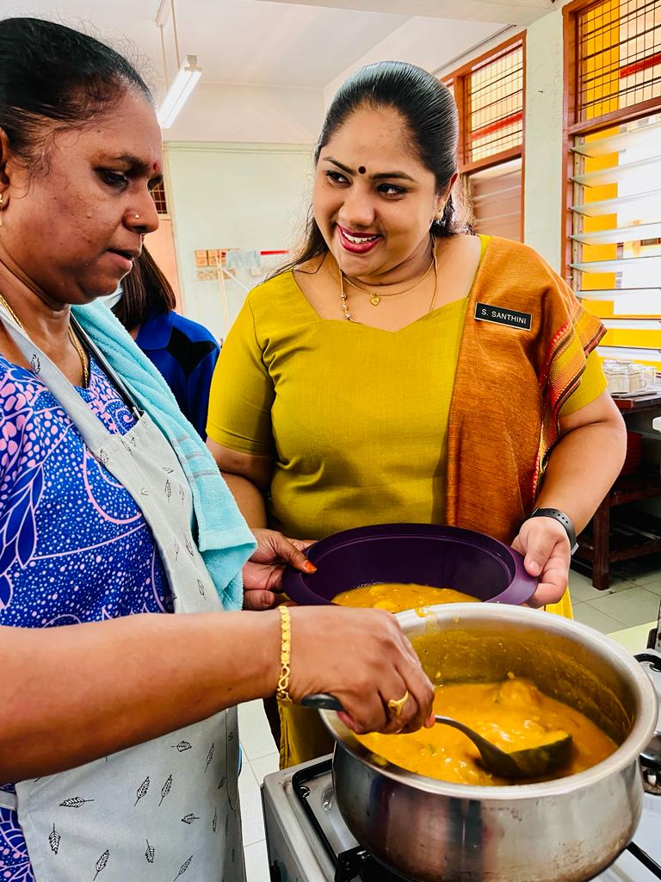
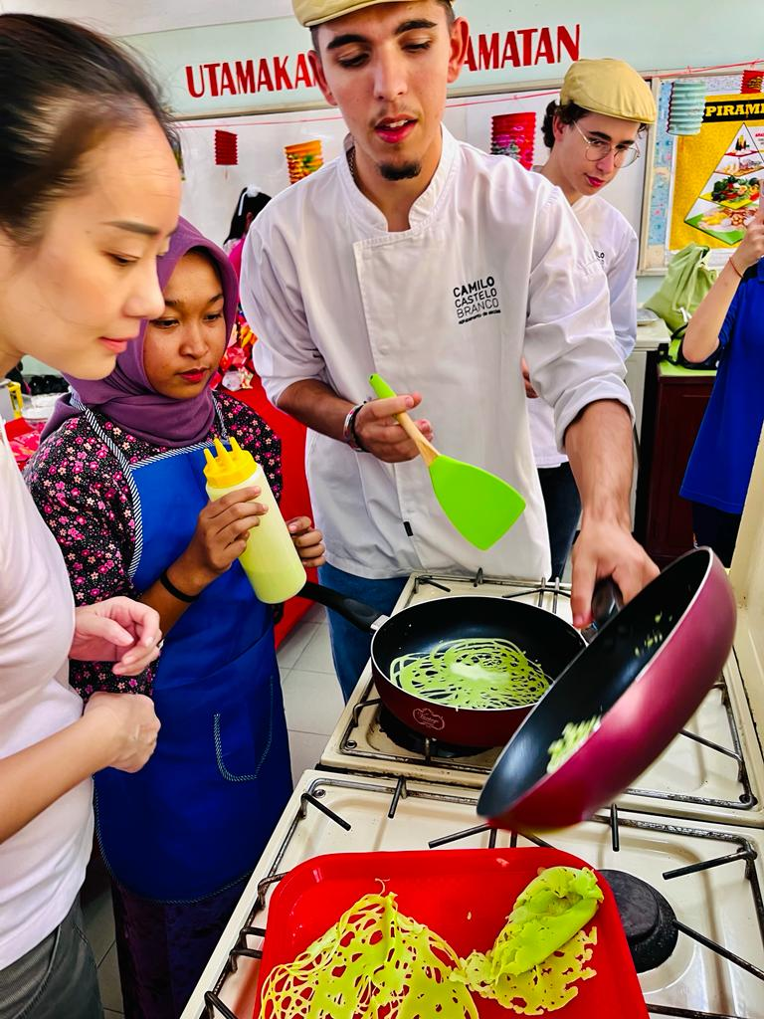
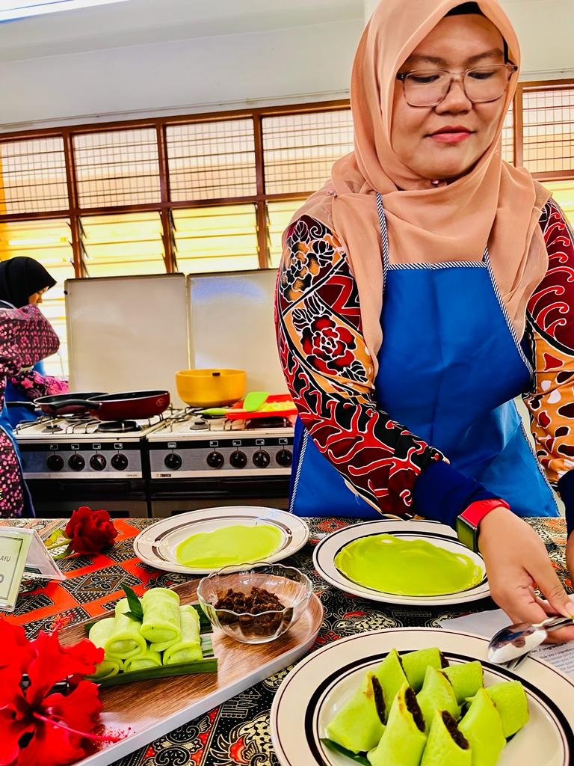
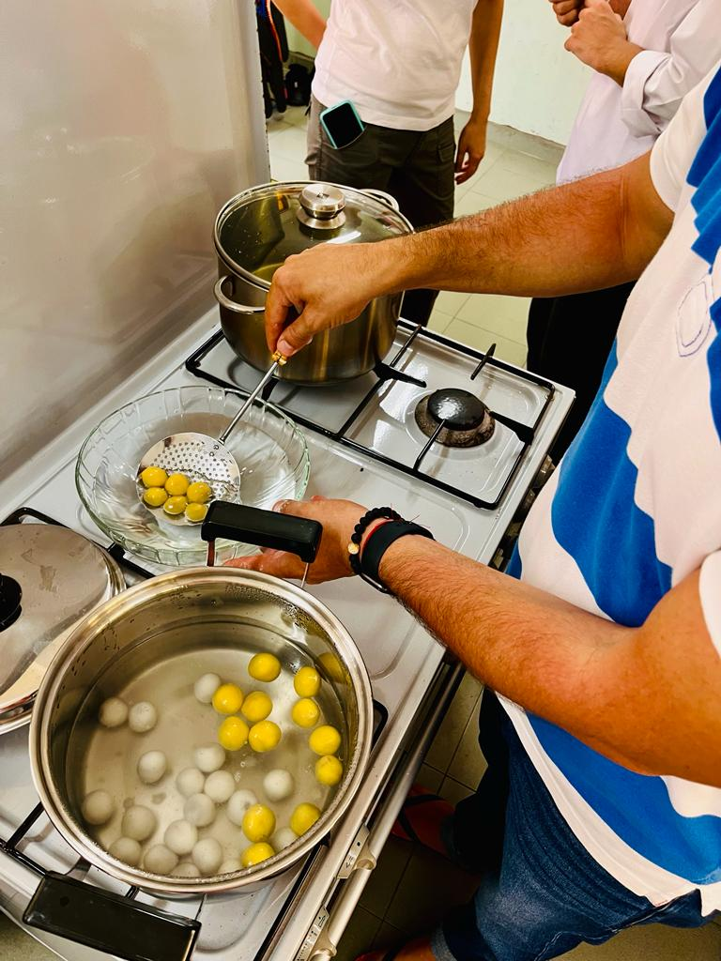
ECO SCHOOL VOCATIONAL TRAINING IN COLLABRATION WITH
INTERNATIONAL URBAN AND REGIONAL COOPERATION
(IURC) ASIA AUSTRALISIA
DAY 3 // Reducing food waste with local and traditional recipes

Slide 16
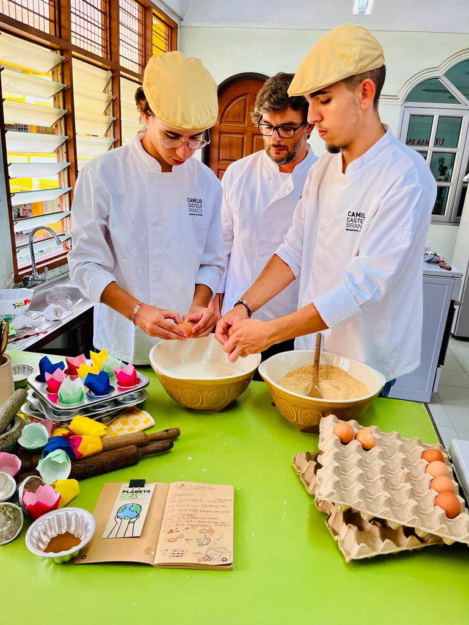
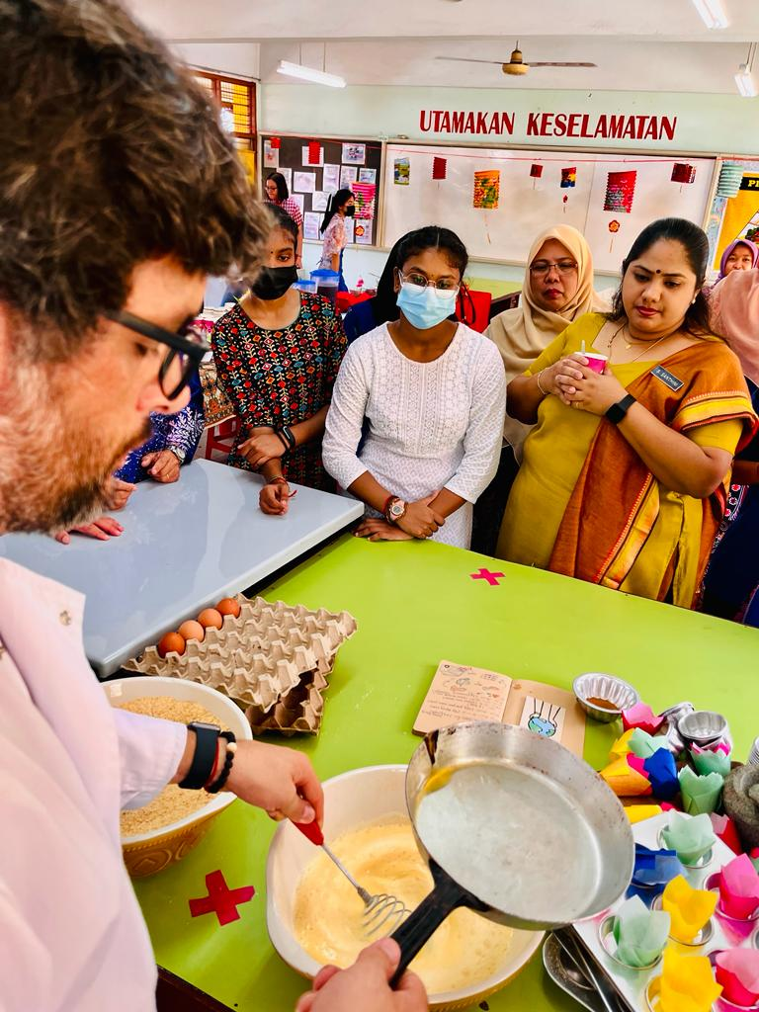
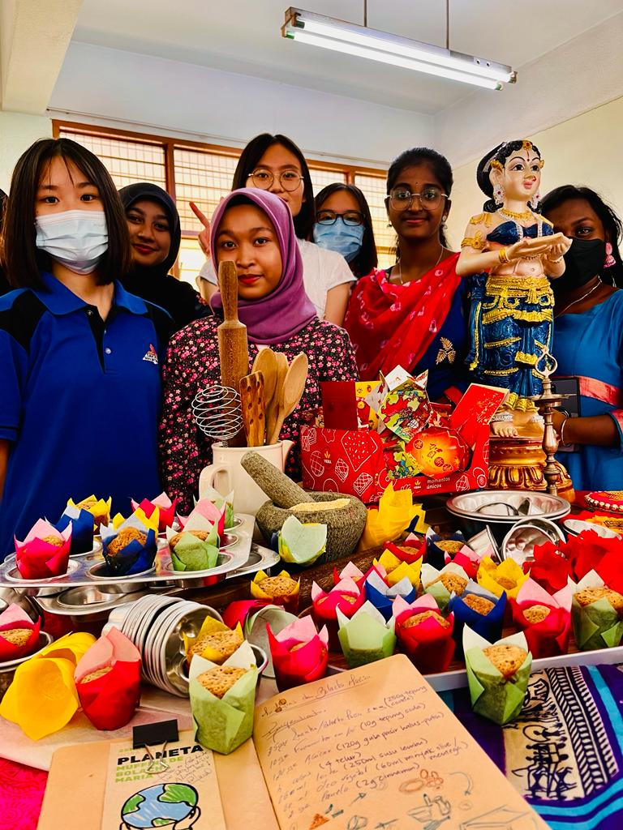
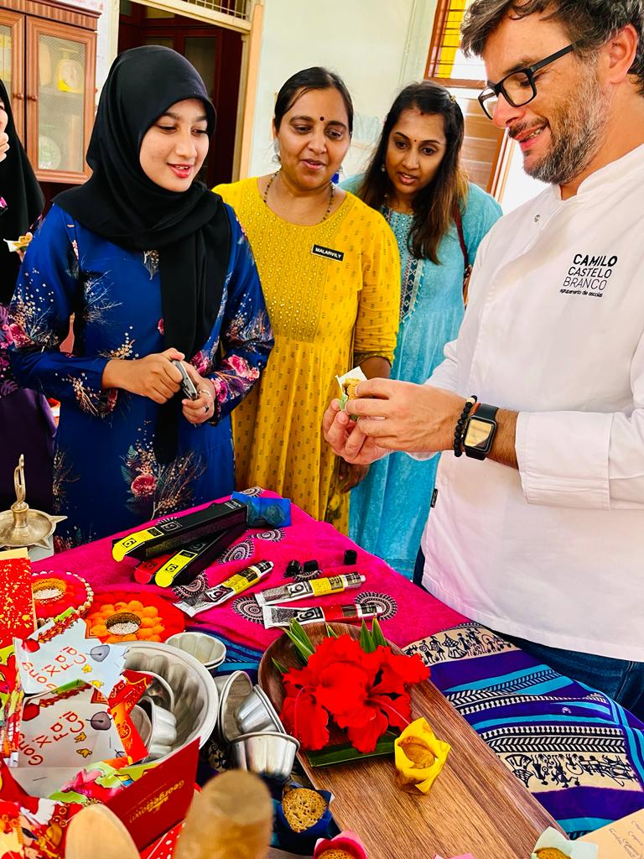
ECO SCHOOL VOCATIONAL TRAINING IN COLLABRATION WITH
INTERNATIONAL URBAN AND REGIONAL COOPERATION
(IURC) ASIA AUSTRALISIA
DAY 3 // Reducing food waste with local and traditional recipes

Slide 17
ECO SCHOOL VOCATIONAL TRAINING IN COLLABRATION WITH
INTERNATIONAL URBAN AND REGIONAL COOPERATION
(IURC) ASIA AUSTRALISIA
Eco-School AE Camilo Castelo Branco
Education has an essential role to play by supporting citizens in developing the competences needed to live responsibly, change consumption models, design solutions, transform society and shape a green economy.
The aim of the proposal is equipping learners with knowledge, skills and attitudes needed to act on sustainability, climate change and biodiversity loss.
This requires learning along three dimensions: cognitive, socio-emotional, behavioural.

Slide 18
ECO SCHOOL VOCATIONAL TRAINING IN COLLABRATION WITH
INTERNATIONAL URBAN AND REGIONAL COOPERATION
(IURC) ASIA AUSTRALISIA
}
Eco-School AE Camilo Castelo Branco
LEARNING IN
LEARNING THROUGH
LEARNING ABOUT
LEARNING FOR
Achieving a “whole-institucion” approach
Engaging communities and students for sustainability
Fostering action competences
Supporting and preparing education personnel

Slide 19
ECO SCHOOL VOCATIONAL TRAINING IN COLLABRATION WITH
INTERNATIONAL URBAN AND REGIONAL COOPERATION
(IURC) ASIA AUSTRALISIA
}
Eco-School AE Camilo Castelo Branco
Students have a chance to design practical activities aiming to make a significant, positive impact in their school or community...
STUDENT ENGAGEMENTE
LEARNING COMMUNITIES
COLLABORATION
bIN, Be part of the solution!
O Mar começa aqui, em Famalicão!
#aeccbplogging
less IS more, B Creative

Slide 20
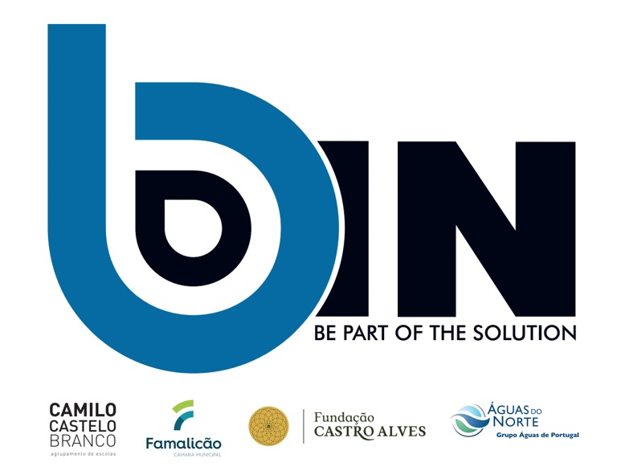


Slide 21
https://bin-be-part-of-the-solution8.webnode.pt/nossos-projectos/
bin.bepartofsolution
https://education-for-climate.ec.europa.eu/community/group/education-climate-days-2022/topic/bin-be-part-solution

Slide 22
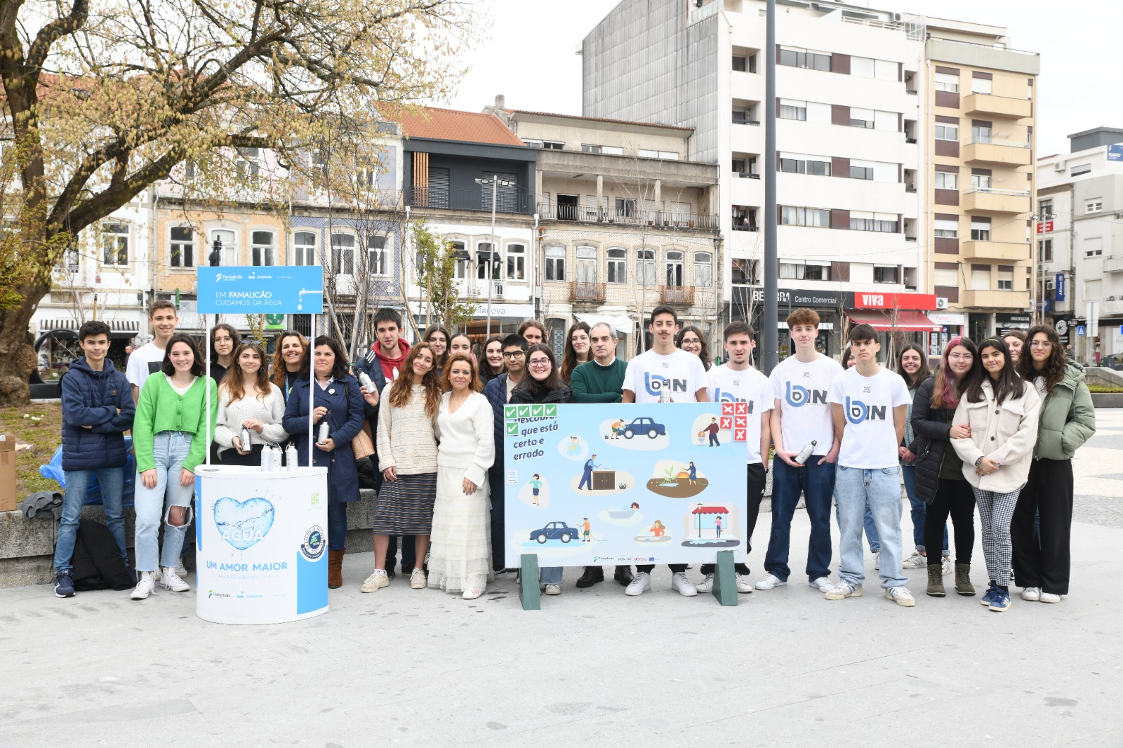

Slide 23
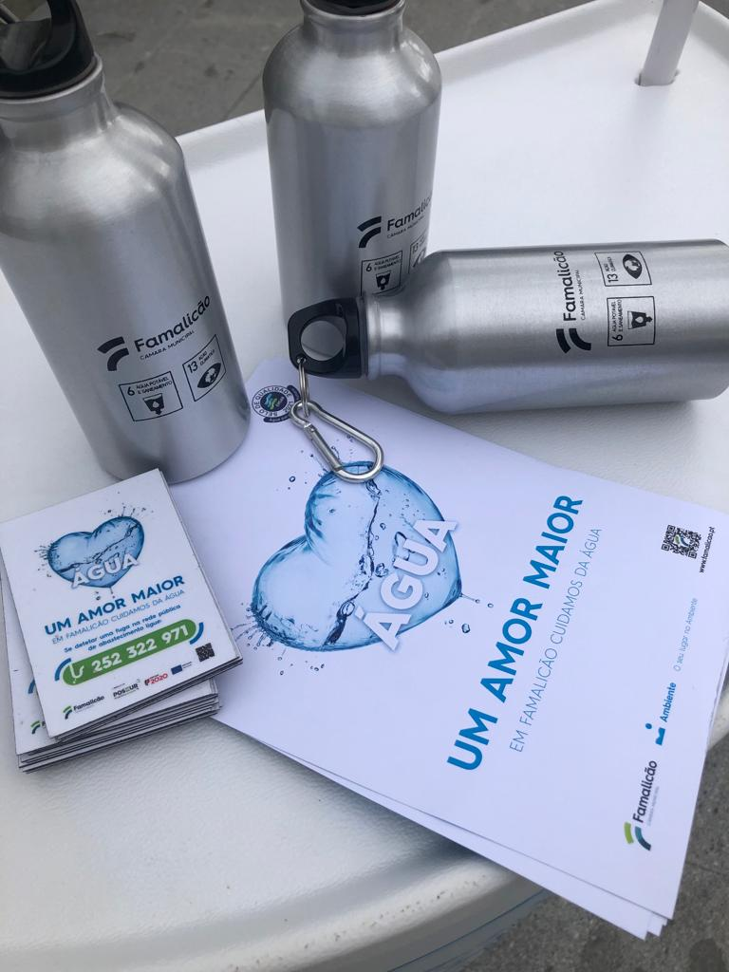
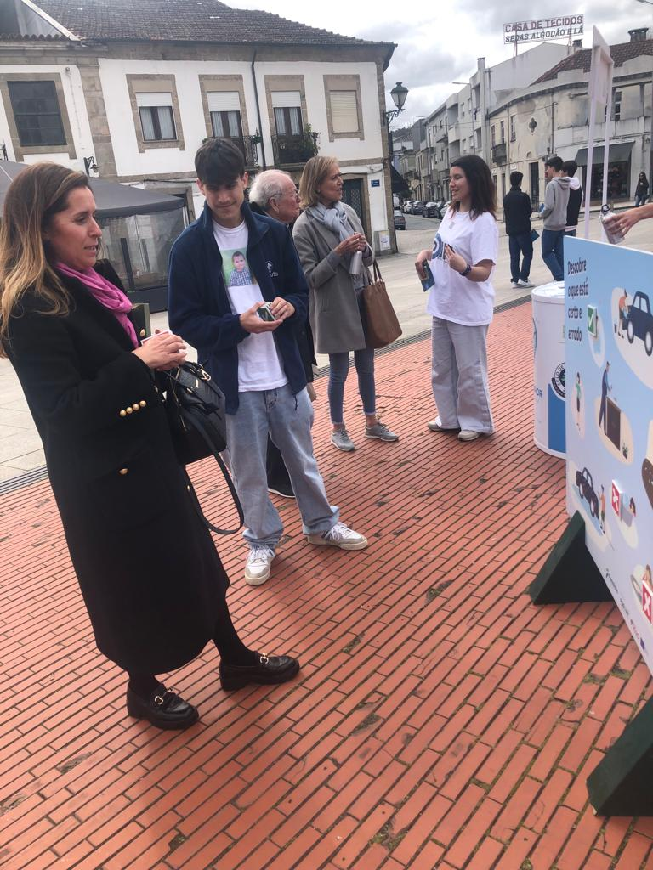

Slide 24


#aeccbplogging
Juntos, a construir o futuro!
Together, building the future!

Slide 25
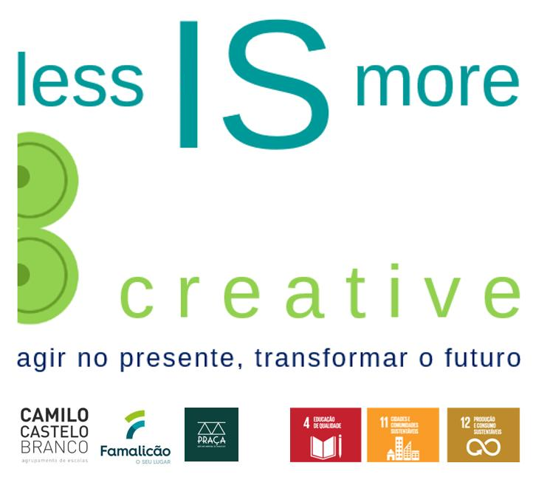

Slide 26
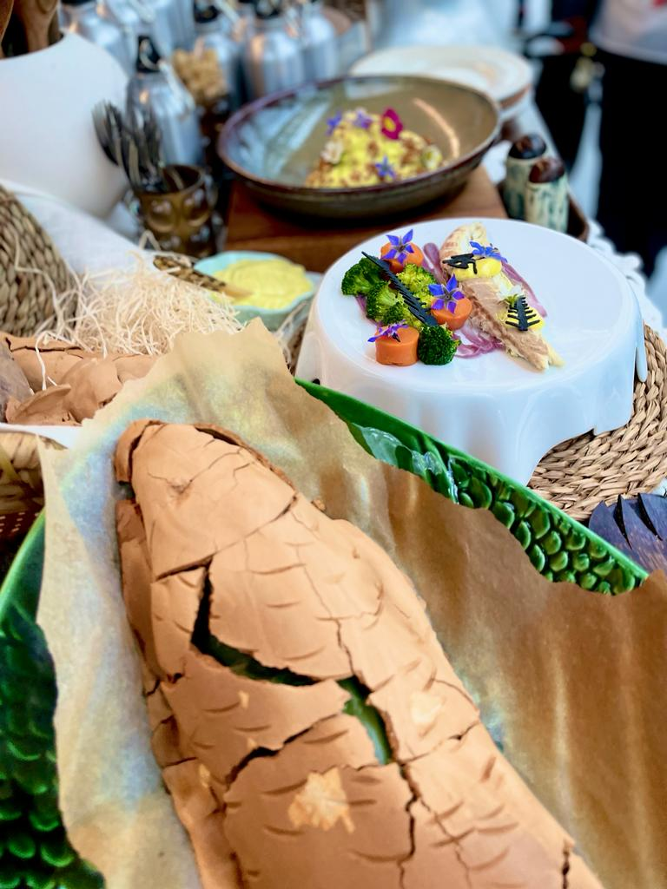
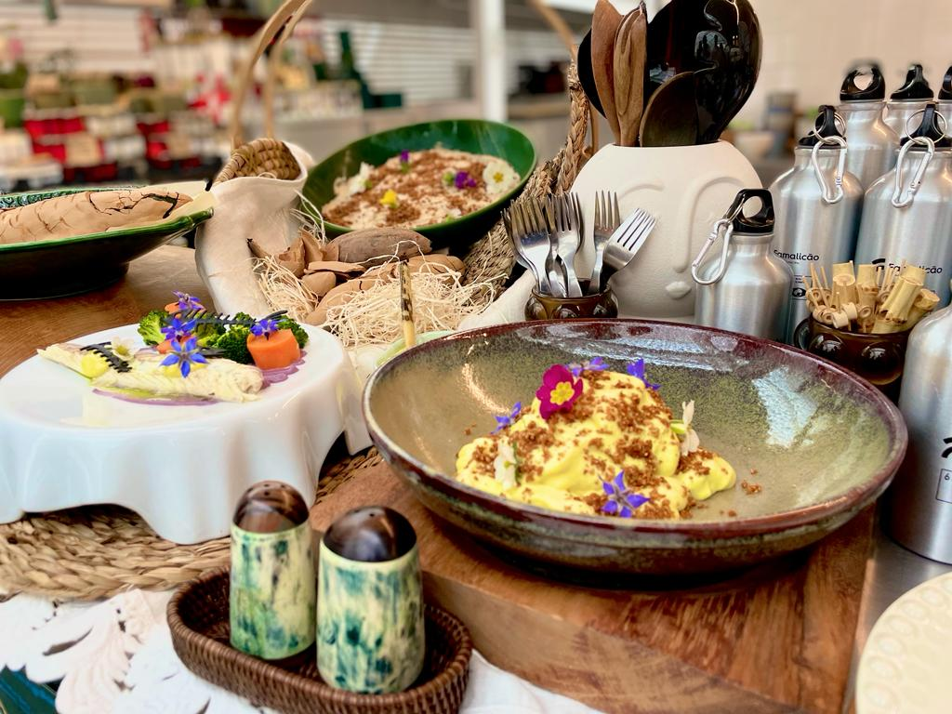
less IS more
B Creative

Slide 27
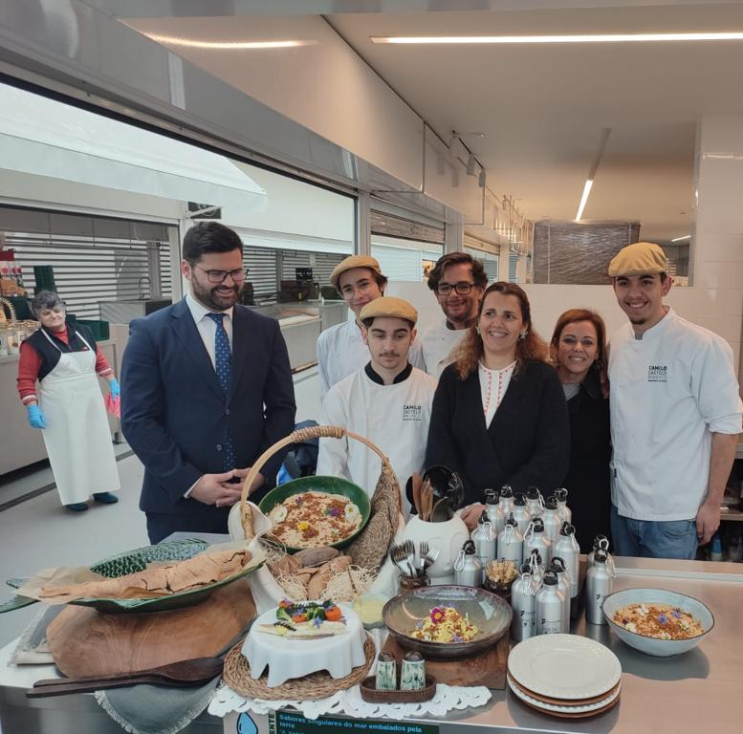
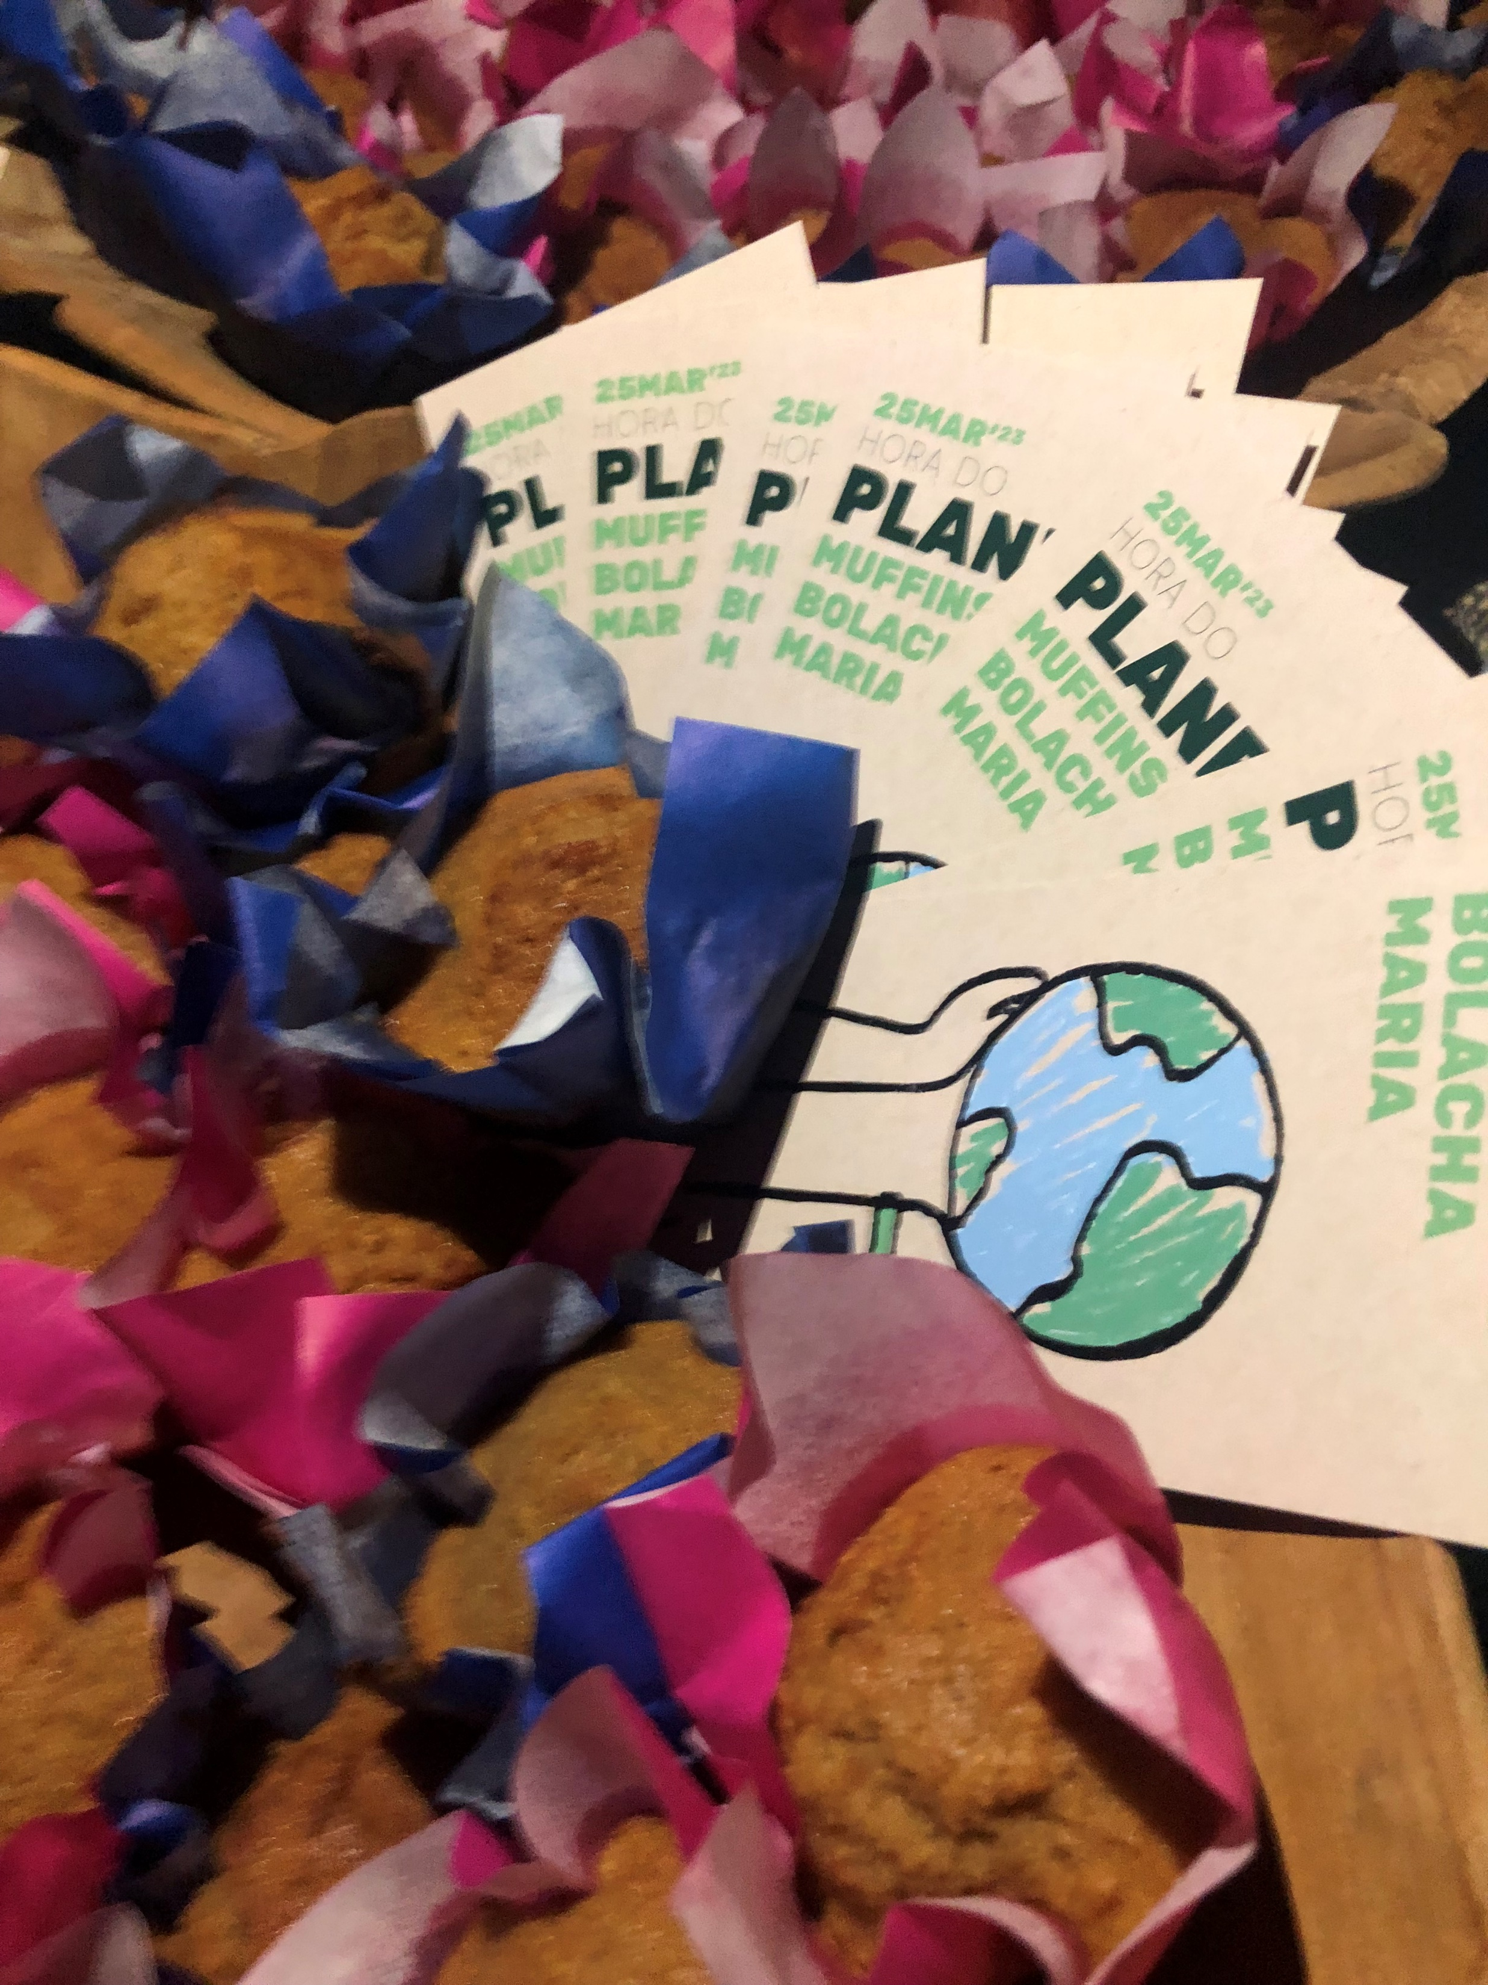
less IS more
B Creative

Slide 28
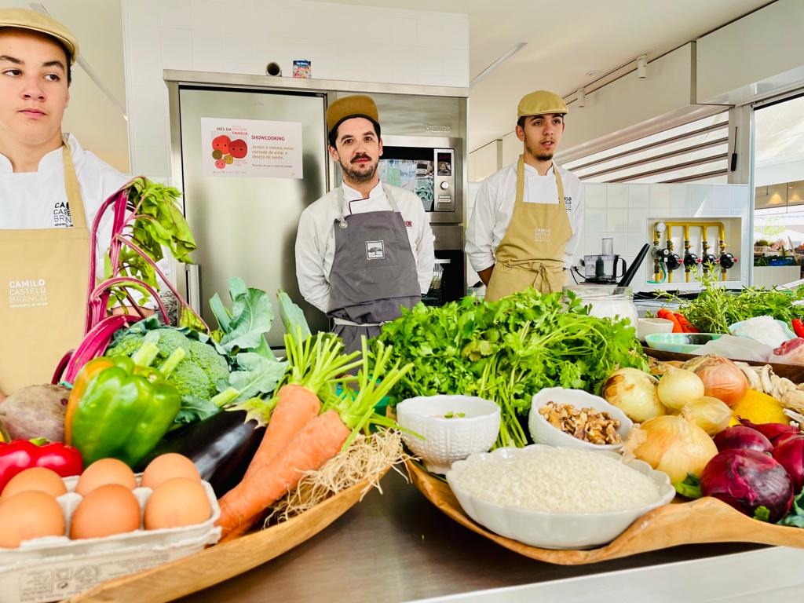

less IS more
B Creative

Slide 29
less IS more
B Creative

Slide 30
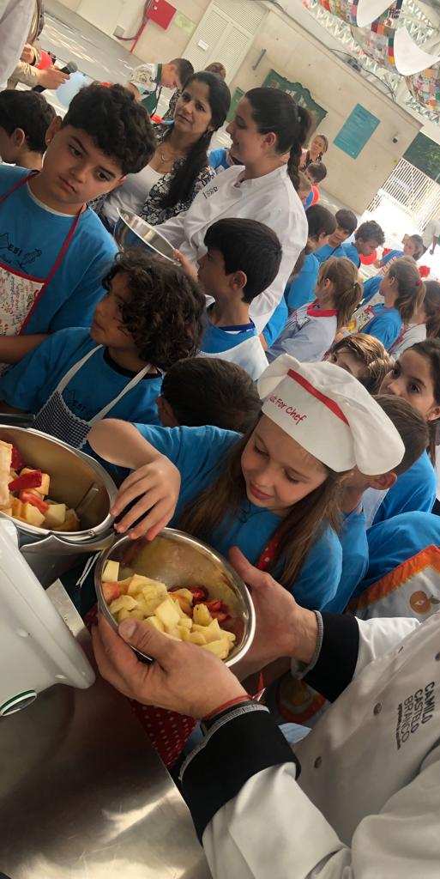
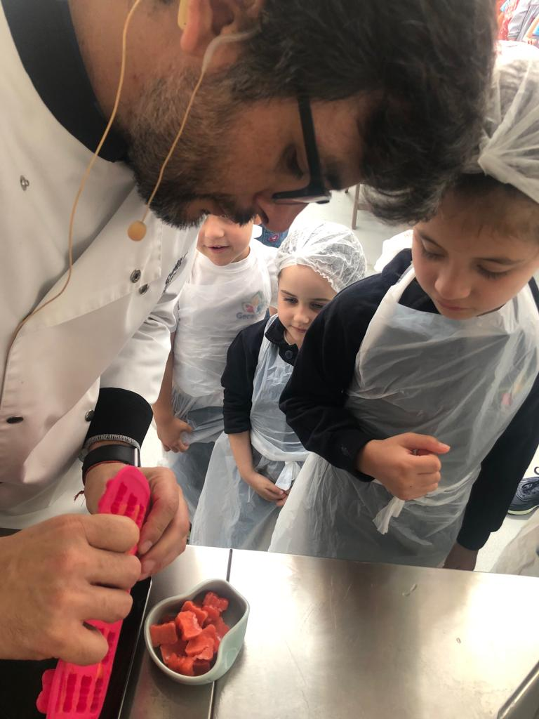
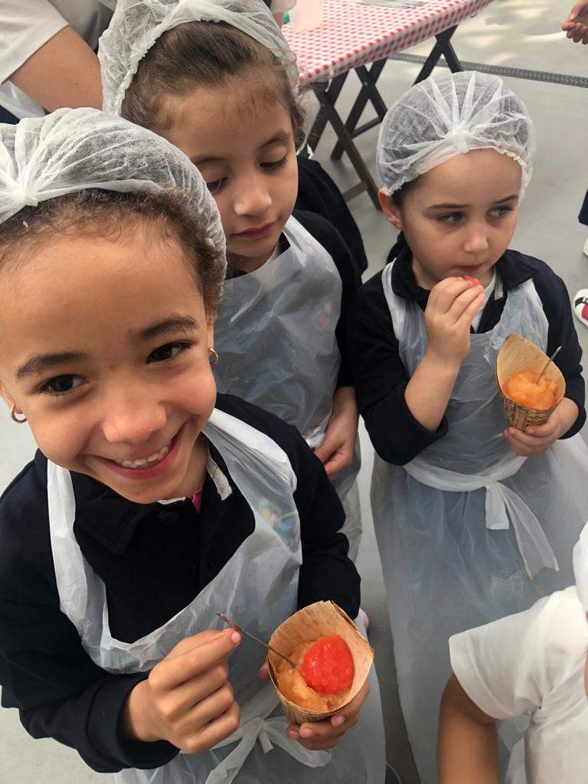
less IS more
B Creative

Slide 31
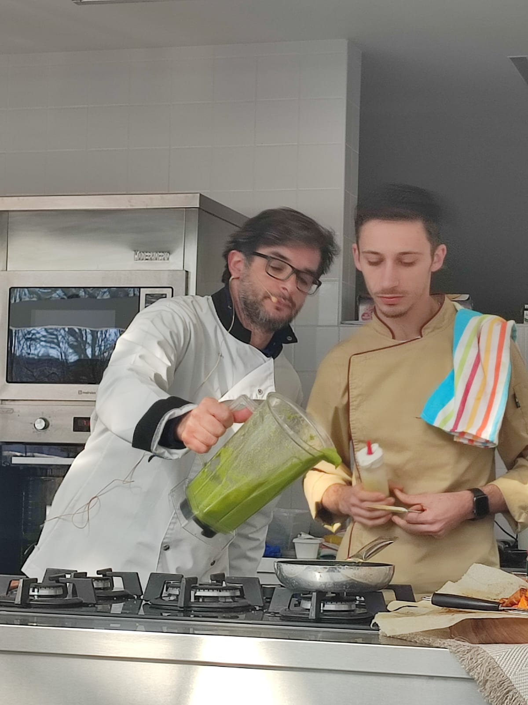
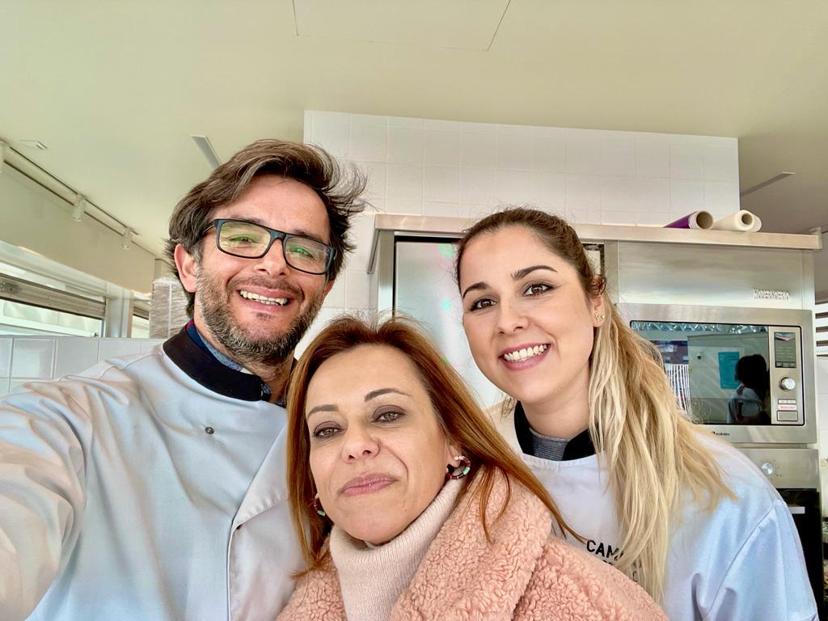
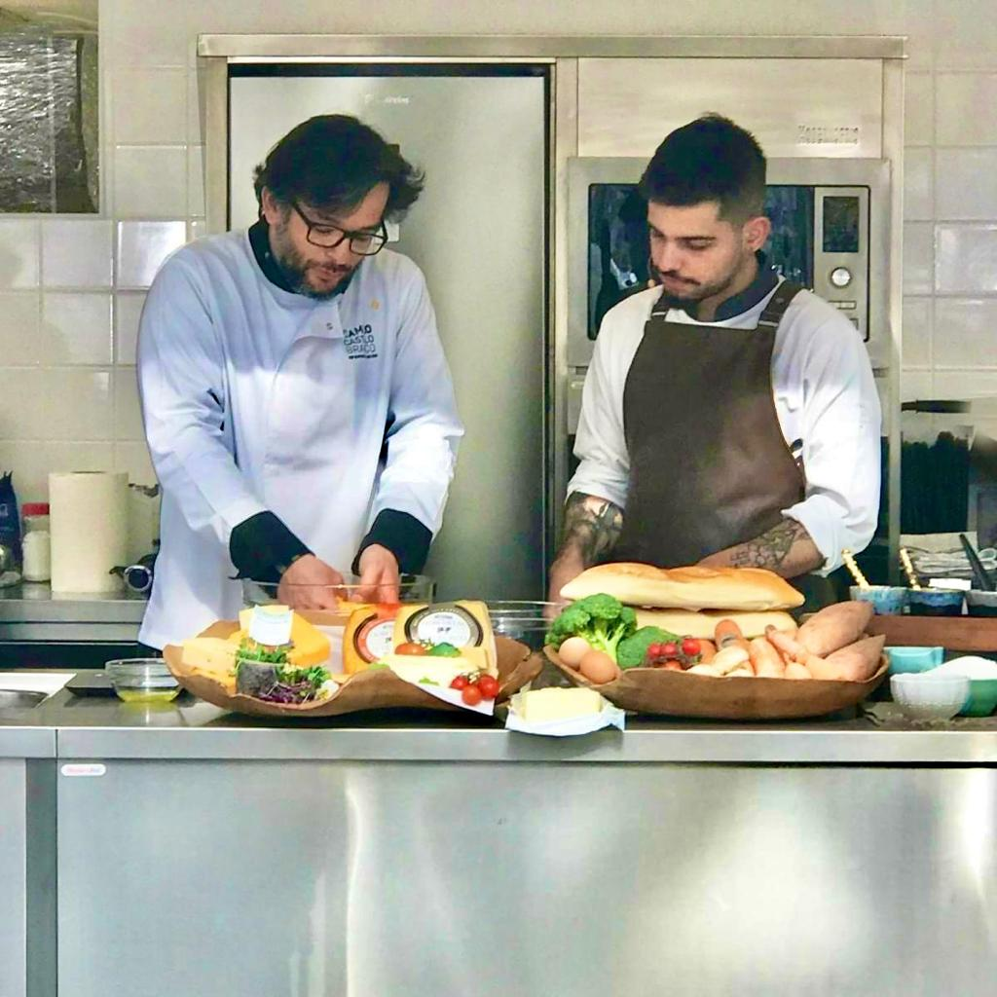
less IS more
B Creative

Slide 32

less IS more
B Creative

Slide 33

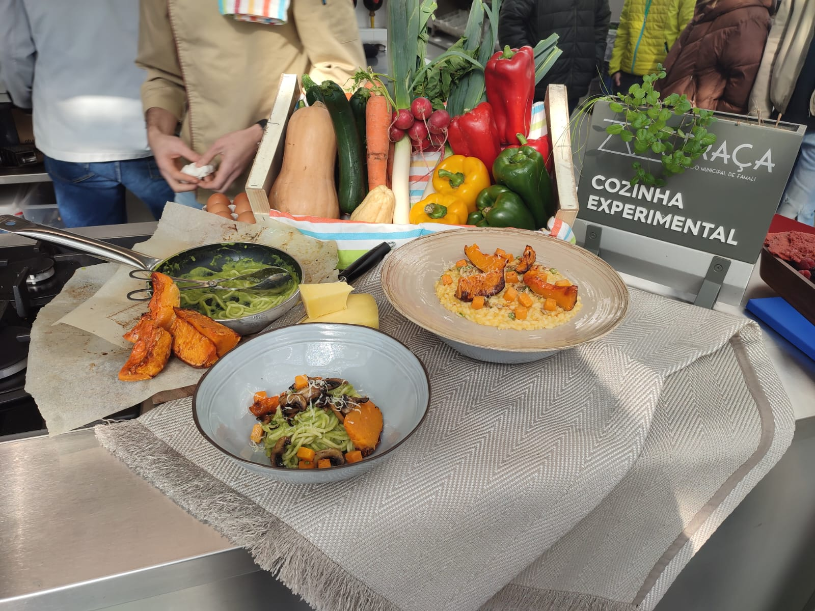
less IS more
B Creative

Slide 34
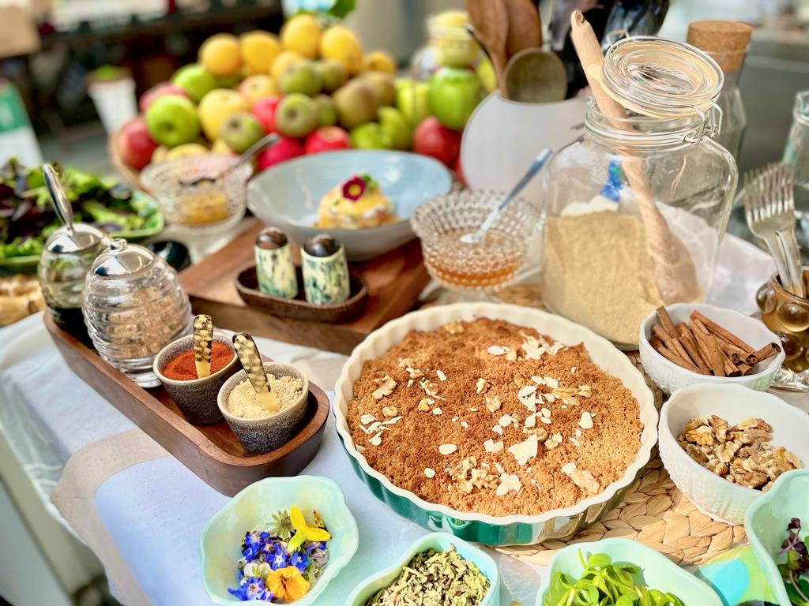
less IS more
B Creative

Slide 35
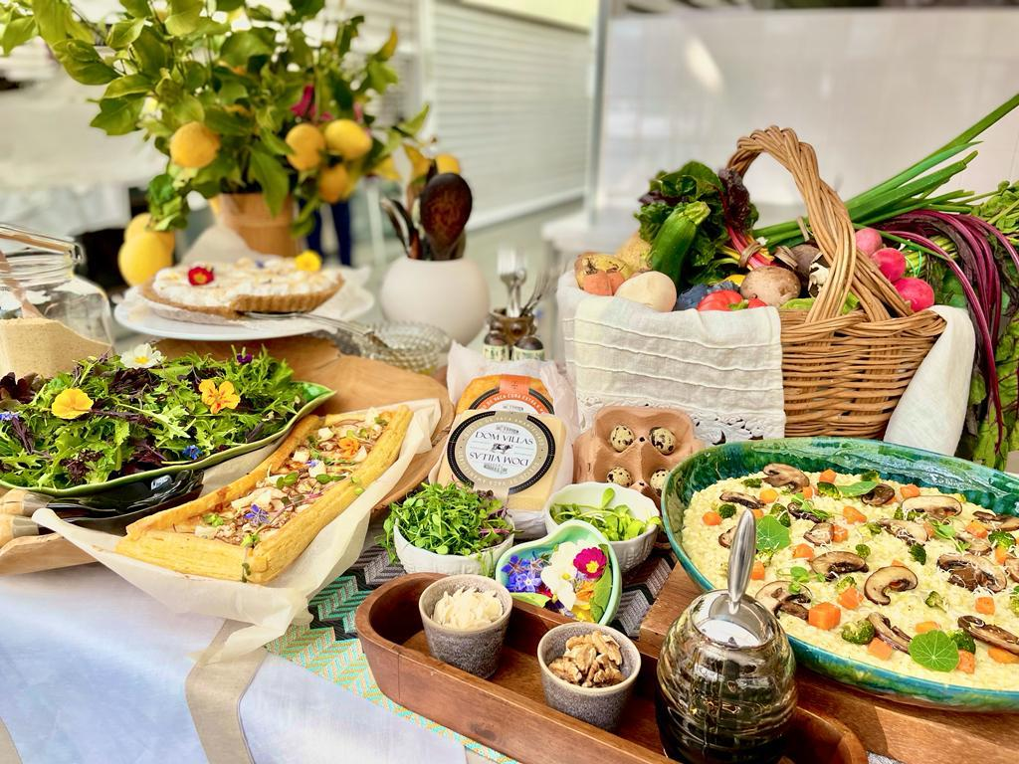
less IS more
B Creative

Slide 36
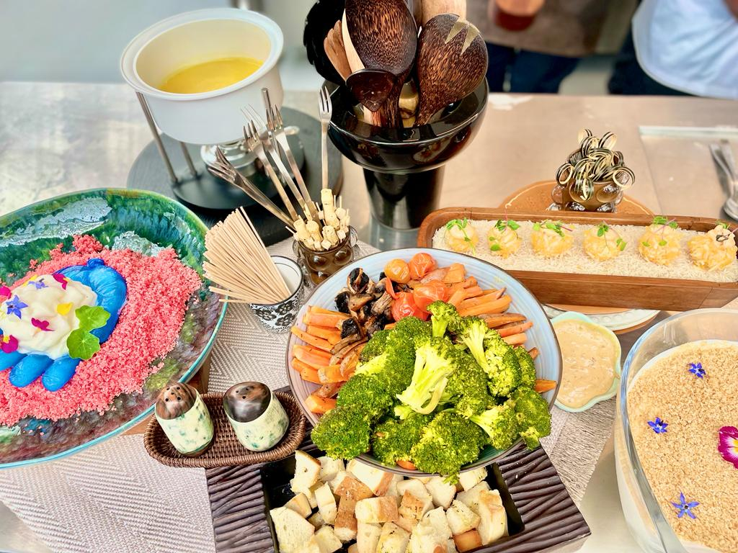

Slide 37
ECO SCHOOL VOCATIONAL TRAINING
IN COLLABRATION WITH
INTERNATIONAL URBAN AND REGIONAL COOPERATION
(IURC) ASIA AUSTRALISIA

