Slide 1
Regional innovation in the EU 欧盟的区域创新
Amadeo Jensana, Cluster manager of IURC
2/6/2022
Amadeo Jensana，IURC China 专题小组欧方专家
2022年6月2日

Slide 2
Regions in Europe 欧洲区域一览
Very different level of autonomy (Ex. Spain versus Portugal).
Classification of regions:
NUTS 1: major socio-economic regions (92)
NUTS 2: basic regions for the application of regional policies (240)
NUTS 3: small regions for specific diagnoses (1169)
差异显著的自治水平（例如西班牙与葡萄牙）。
区域分类方式：
NUTS 1：主要社会经济区域（92个）
NUTS 2：落实区域政策的基本区域（240个）
NUTS 3：实现特定功能的小型区域（1169个）
注：NUTS：欧盟标准地域统计单元

Slide 3
European Structural and Investment funds 欧洲结构和投资基金
European Regional Development Fund (ERDF)
European Social Fund (ESF)
Cohesion Fund (CF)
European Agricultural Fund for Rural Development (EAFRD)
European Maritime and Fisheries Fund (EMFF)
欧洲区域发展基金 (ERDF)
欧洲社会基金 (ESF)
凝聚力基金 (CF)
欧洲农村发展农业基金 (EAFRD)
欧洲海洋与渔业基金 (EMFF)

Slide 4
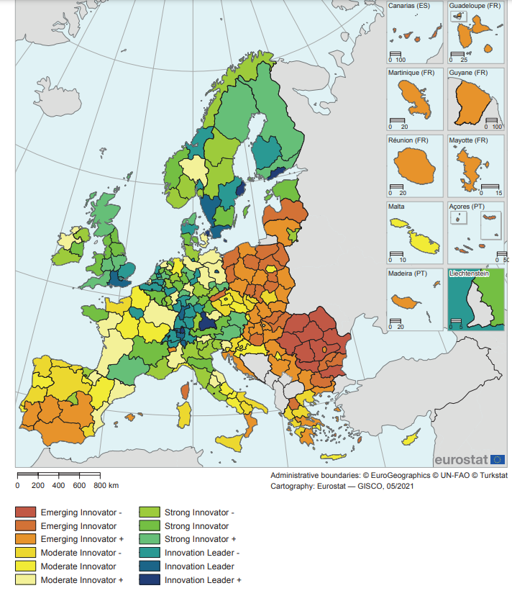
Regional innovation scoreboard 区域创新记分牌

Slide 5
Smart Specialisation Strategies 智慧专业化战略
It is a bottom-up process. It should be an inclusive process of stakeholders’ involvement centred on the entrepreneurial discovery process involving the private sector, universities and government.
The strategy should embrace a broad view of innovation, supporting technological as well as practice-based and social innovation.
The importance of monitoring and evaluation is crucial.
自下而上的进程。这是一个利益相关方参与的包容性进程，专注于创业探索和培育，涉及私营部门、大学和政府。
此类战略应包含创新的宽阔视野，支持技术、实践和社会创新。
监测与评估至关重要。

Slide 6
Smart Specialisation Strategies 智慧专业化战略
The scope of innovation includes not only science and technology, but also design, creativity, services, business models, and solutions to social issues.
The strategy calls for constant review to avoid fixation on a particular field and indicates the need for a system that is agile and responsive to change.
创新范围不仅包括科学技术，还包括设计、创意、服务、商业模式以及社会问题的解决方案。
此类战略要求持续评估，以避免固化在某一特定领域，并需要一个及时响应变化的灵活系统。

Slide 7
Entrepreneurial Disscovery Process 创业发现进程
To determine how regional priorities for research and innovation investment are selected.
Stakeholder collaboration (private and non private).
Implementation of priorities
Development of specific frameworks and tools.
Establishment of horizontal and vertical innovation networks.
Monitoring and evaluation mechanisms
Source: Foray
确定如何选择研究和创新投资的区域优先事项。
利益相关方协作（私营和非私营）。
落实优先事项
开发具体框架和工具
建立横向和纵向创新网络
监测与评估机制
资料来源：Foray

Slide 8
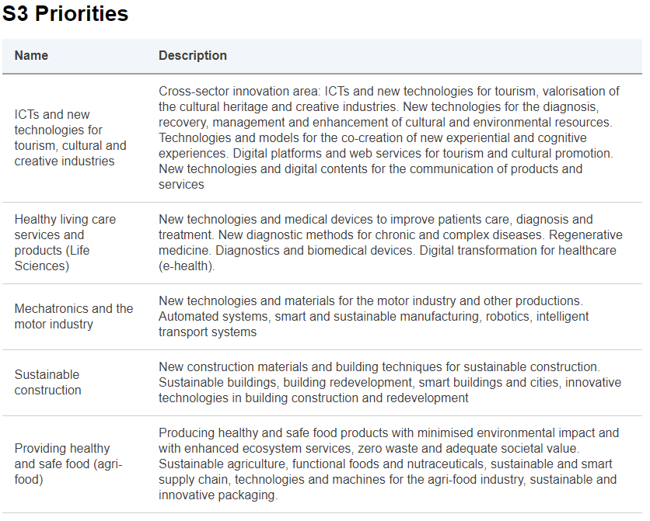
Example. Emilia Romagna 范例 - 艾米利亚-罗马涅大区
S3 优先事项
名称
应用于旅游、文化及创意行业的信息和通信技术和新技术
健康生活护理服务和产品
（生命科学）
机电一体化和电机行业
可持续建筑
提供健康安全食品
（农业食品）

Slide 9
Example. Basque country 范例 - 巴斯克自治区
Advanced manufacturing: automotive, aeronautical, railway, naval, capital goods, machine tools, and metal sectors. “Industry 4.0”. Business clusters have so far assumed the leadership of the group
Energy: renewal energies such as wind power, solar thermal power, as well as in other areas such as energy storage or intelligent networks.
Health and biosciences: the leadership in developing the sector was assumed by several departments of the Basque government together with the public the Basque foundation for health, innovation and research.
先进制造业：汽车、航空、铁路、舰艇、资本货物、机床和金属行业。“工业4.0”。迄今为止，企业集群一直主导制造业发展。
能源：可再生能源，如风电、太阳能热发电以及其他领域，如储能或智能网络。
健康和生物科学：巴斯克政府的几个部门与巴斯克卫生、创新和研究公共基金会共同主导行业发展。

Slide 10
Thank you!谢谢！
Amadeo Jensana
ajensana@casaasia.es
This presentation was produced with the financial support of the European Union. Its contents are the sole responsibility of Amadeo Jensana and do not necessarily reflect the views of the European Union.
本演示文稿的制作得到欧盟资金支持。演示文稿的内容完全是作者 Amadeo Jensana 的意见，不一定代表欧盟的观点。

