Slide 1

Development of Public Transportation in the City of Semarang
Bilateral Meeting Between Semarang City Government and Sofia City
January 13th, 2022

Slide 2
DEVELOPMENT OF ROAD-BASED TRANSPORTATION
BRT has used Gas Fuel
Development Plan of BRT dedicated Lane
New BRT Replacement Plan using electric bus

Slide 3
CONSTRUCTION OF BRT DEDICATED LANE . . . . .
CURRENT CONDITION
643 units of shelter
245 buses serving 8 corridors and 3 feeder
287 mobile e-ticketing machines
The BRT TRANS SEMARANG Application is available on the Google Play Store (Bus routes and corridors, information on the nearest bus and shelter, real time update).
Gender segregation on the bus, there is a special place for the disabled, and there is also a place for folding bicycles (if the bus is not full)
A study of traffic impact analysis, Environmental assessment, and income potential has been carried out

Slide 4
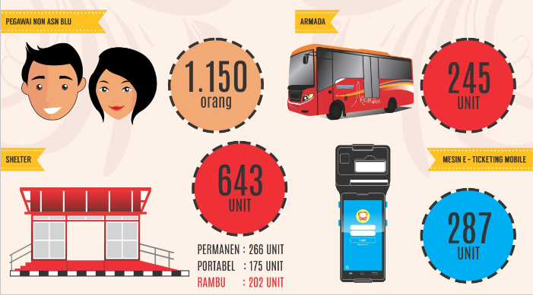
Non-Gov Employees of Public Service Agency
VEHICLE
Peoples
E-Ticketing Mobile Machine
PERMANENT : 266 UNIT
PORTABLE : 175 UNIT
SIGN : 202 UNIT

Slide 5
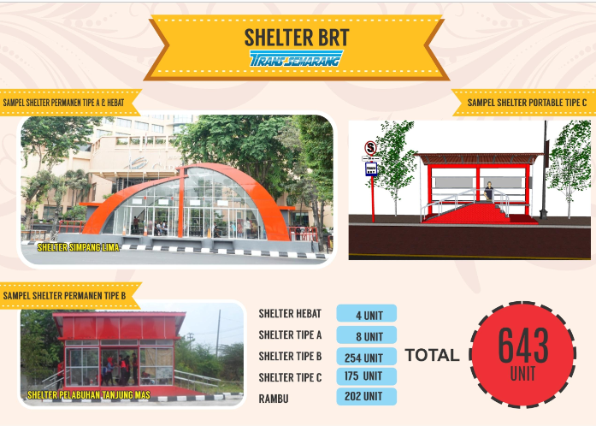

Slide 6
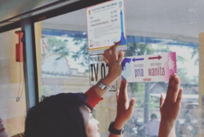
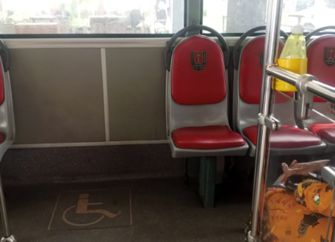
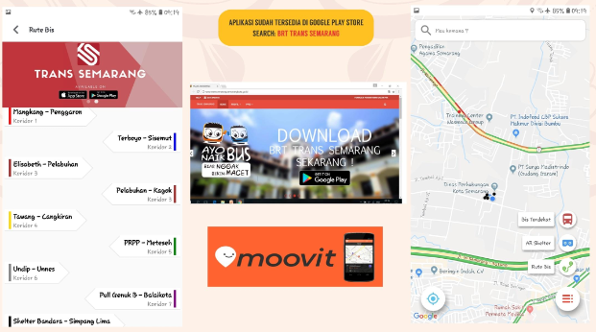
Gender Segregation
Space for Disable
BRT TRANS SEMARANG Application

Slide 7
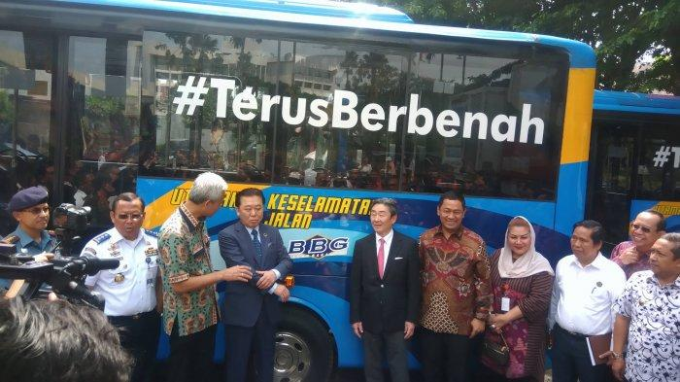
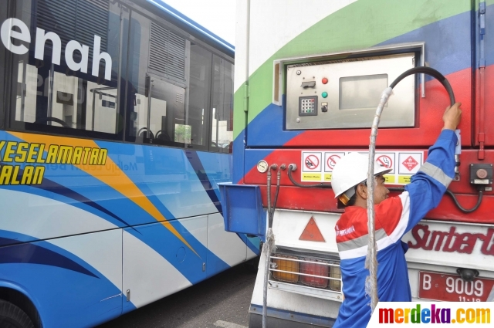
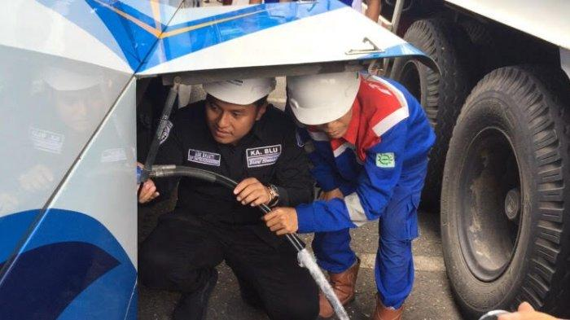
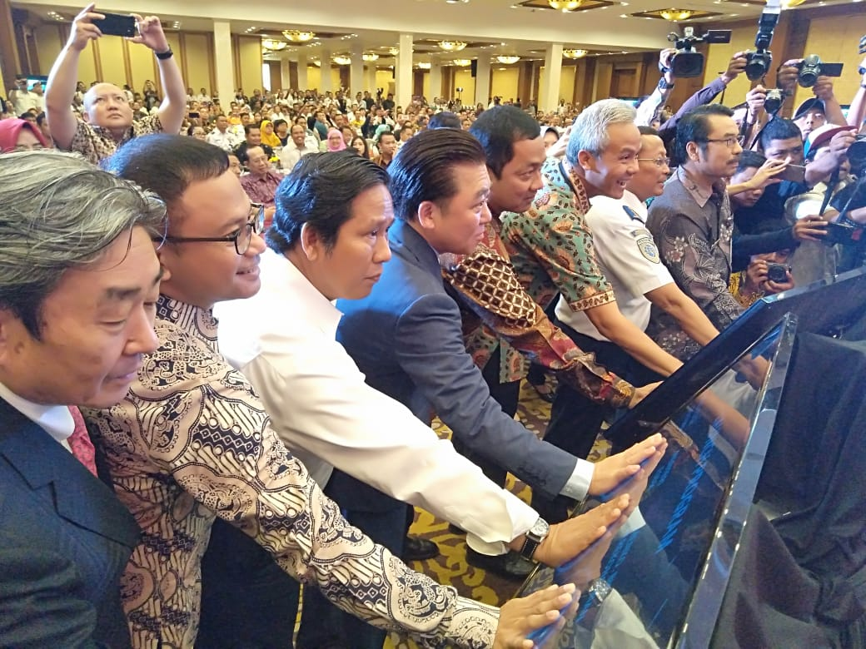
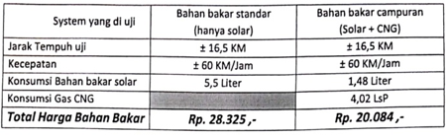
BRT BERBAHAN BAKAR GAS
BRT WITH GAS FUEL
CONVERTER KIT CNG TRANS SEMARANG
Budget : ± Rp 10 Billion
JCM Subsidy : ± Rp 5 Billion (MOE Japan)
Unit : 72 bus (4 corridors)
Composition : 30 % diesel fuel, 70 % gas
Year : 2018
Reduce 1.870 Ton CO₂e , and reduce 29% operational cost.

Slide 8
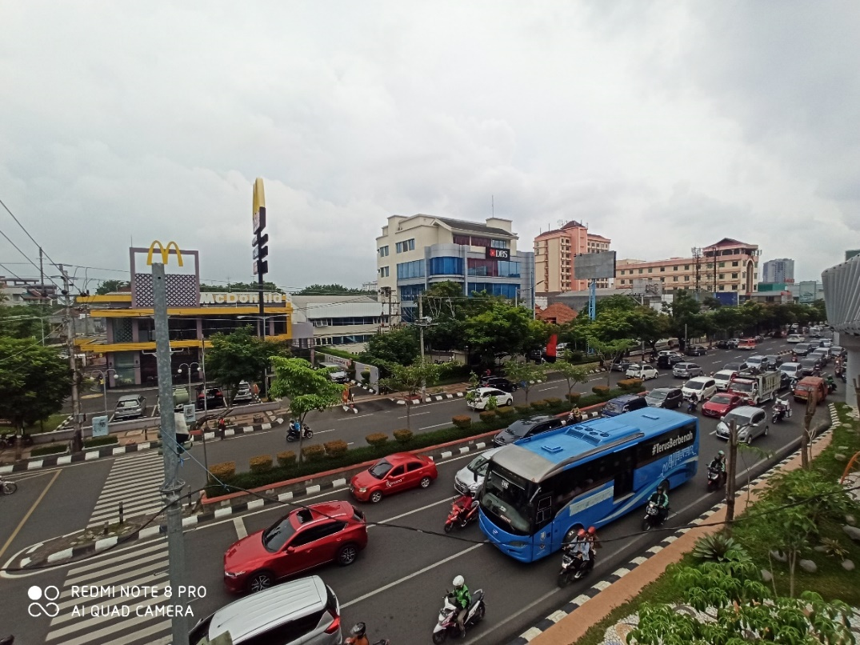
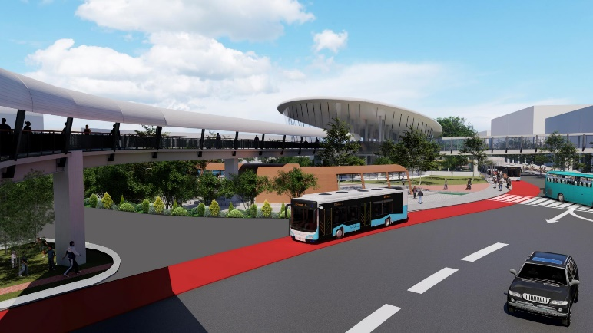
CONSTRUCTION OF BRT DEDICATED LANE
Purpose :
Provision of dedicated lanes for BRT so that travel times and speeds can be ensured

Slide 9

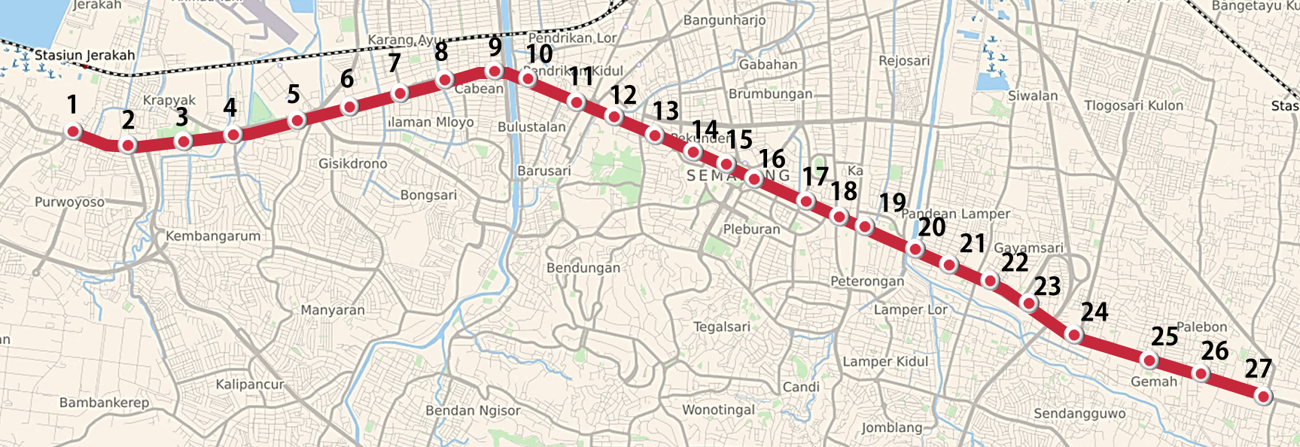











Project Highlight: “New BRT Semarang”
Service Profile “New BRT Semarang”
Dedicated Lane Corridor & Planned BRT Stop Points
13 km
BRT Dedicated Lane
27 stops
Along the dedicated lane corridor
23 route
Direct Service
Bund. Kali Banteng
Tugu Muda
Simp. Ngaliyan
Simp. Pedurungan
Simp. Lima
515 bus
Low Floor, EURO-IV
+converter kit CNG
RoW
40m
RoW
40m
RoW
35m
RoW
30m
2023
Initial target of operation
142.000 passengers/day
Daily passengers (year 2023)
National Road
City Road
Province Road
Coverage 23 rute BRT Direct Service
34.000 tonCO₂
Emission reduction (year 2023)
Districts
100%
Medical facility
52%
++
Sub-Districts
>88%
Educational facilities
55%
Revitalize sidewalks, take roads, cycle paths along corridors
Area
33%
Coverage is calculated with a buffer distance of 400 m from the service path taking into account the built-up area..
All Stops
on the dedicated lane corridor Inter-route integration
Population
46%

Slide 10
CONSTRUCTION OF BRT DEDICATED LANE . . . . .
Obstacles/ Challenges
Road authority issues that require further coordination
The width of some roads that are not ideal
Further study is needed to determine financing needs
Solution Plan
The process of submitting a Traffic Impact Analysis to the Ministry of Transportation
Opening PPP schemes and Funding from Province Government and Central Government.

Slide 11
UPGRADING To ELECTRIC BUSES
PURPOSE
To reduce pollution and fuel consumption.
CURRENT CONDITION
Planning Document is not yet available (still in the identification stage)
OBSTACLE/ CHALLENGE
It has not been mapped because there is no planning document / study yet
SOLUTION
As a pilot project, it is planned that in 2022 there will be the purchase of an electric bus unit, which will be used as a tourist bus.

Slide 12
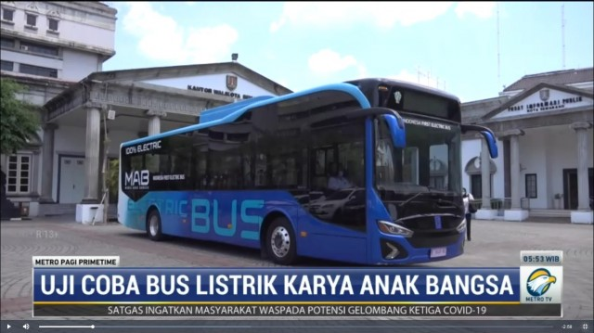
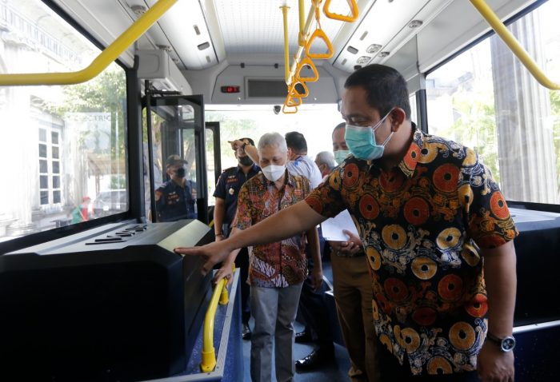
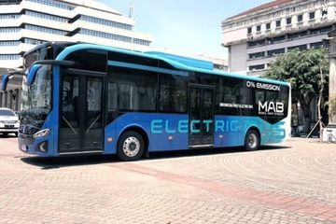
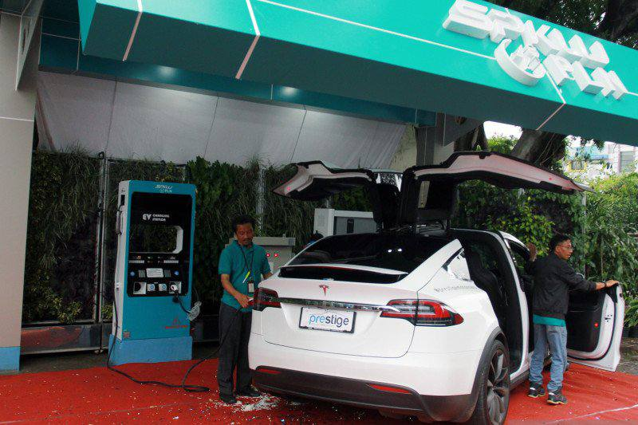
ELECTRIC BUS
ELECTRIC VEHICLE DEVELOPMENT : 5 PUBLIC CHARGING STATION

Slide 13
DEVELOPMENT OF RAIL-BASED TRANSPORTATION
Tram Reactivation
LRT Development Plan

Slide 14
TRAM REACTIVATION
Purpose :
Reducing traffic jams and developing tourism, especially in the Old Semarang area
Current Condition :
At the stage of feasibility studies and service potential as well as the development of the tram lane.
Obstacles/ Challenges
Flood and tidal flood
Financing for the Provision Tram and its infrastructure
Solution :
Semarang City Government in collaboration with PT KAI and PT INKA (as vertical agencies authorized to implement Tram Reactivation)
Semarang City is carrying out river normalization and adding flood pump capacity.

Slide 15
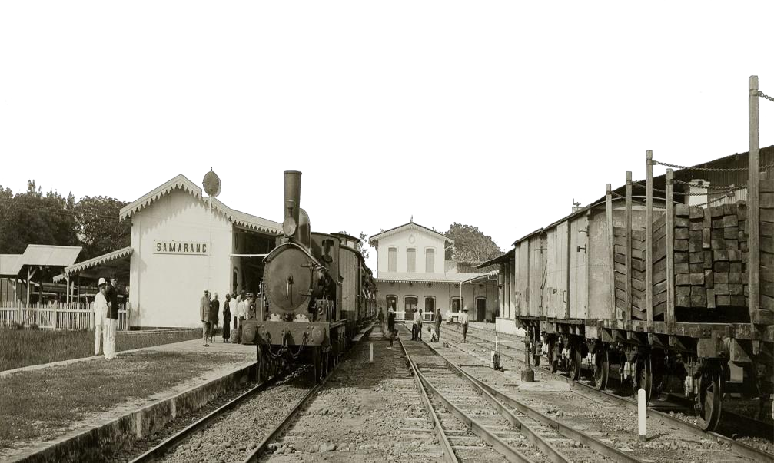
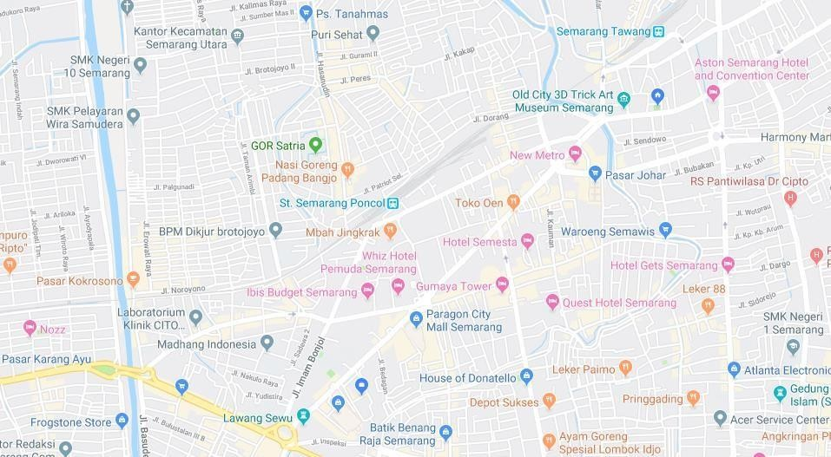
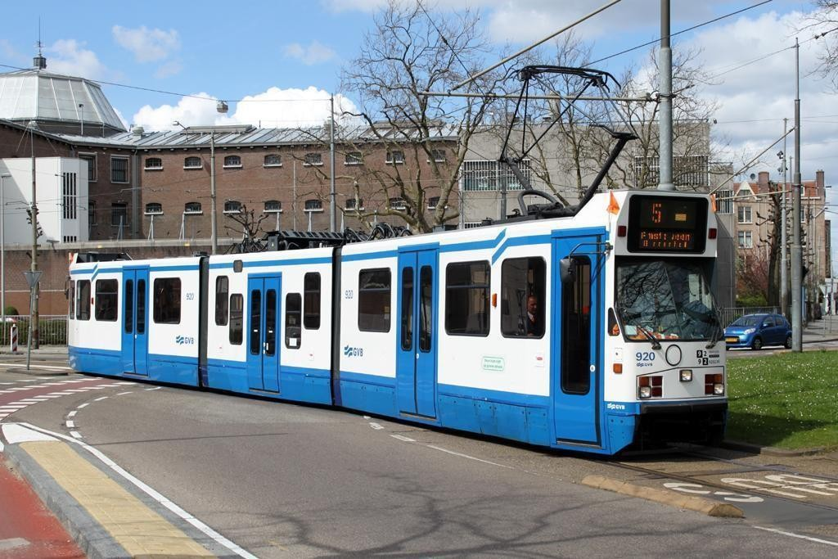
TRASE 1 WEST
SEMARANG CITY TRAM REACTIVATION ROUTE PLAN
Tawang Station
Ronggowarsito
Agus Salim
Johar Market
Pemuda
Poncol Station
Imam Bonjol
Bulu
Lawang Sewu

Slide 16
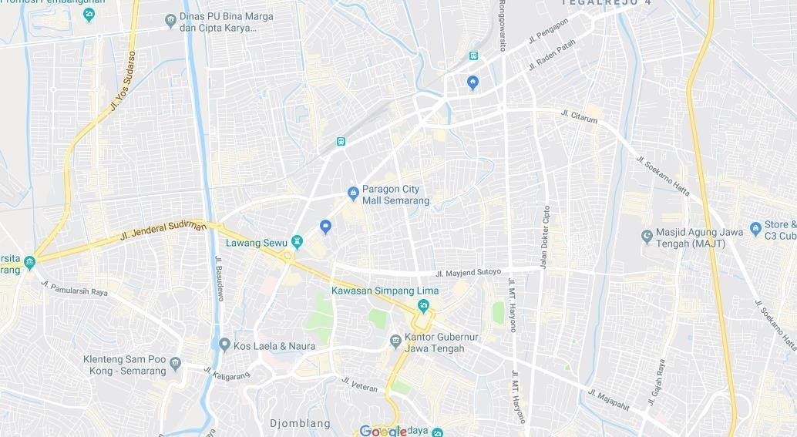
TRAM REACTIVATION PLAN
TRASE 2 EAST
Tawang Station
Dr. Cipto
Peterongan
Sriwijaya
Depok
Gajahmada
Pahlawan

Slide 17
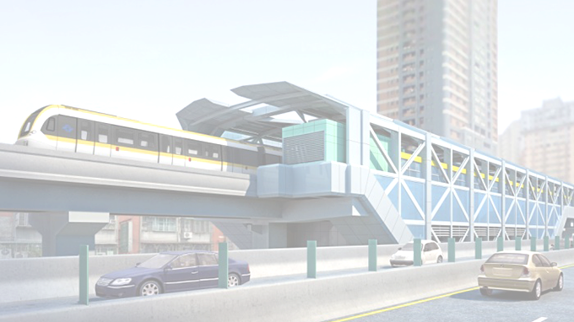
LRT DEVELOPMENT PLAN
Purpose :
Overcoming the increasing demand for transportation that caused by the unbalance number of roads and vehicles
Current Condition :
The financing plan with the Solicited-PPP Scheme, the current stage has reached the preparation of the OBC Document (2019).
Challenge :
Financial Support for the preparation of the FBC Document from Central Government.
Solution :
The Semarang City Government has coordinated with the Central Government for the preparation of FBC Document
The Unsolicited-PPP scheme has been initiated.

Slide 18
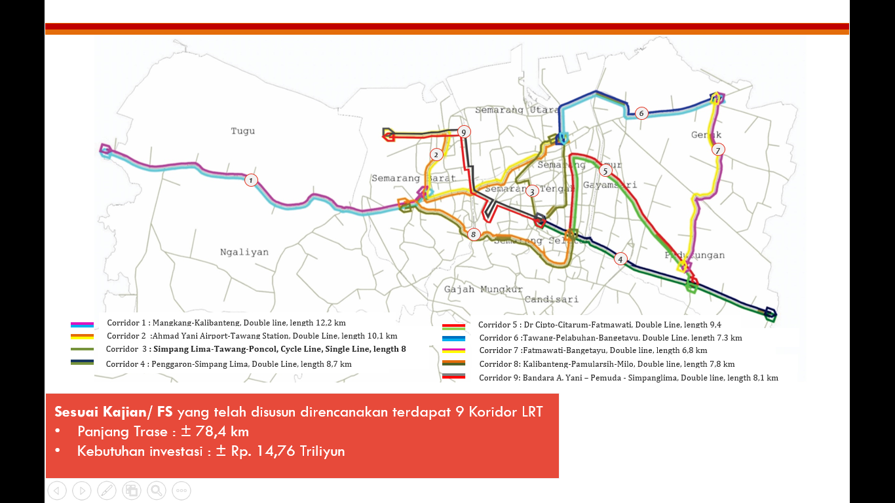
LRT Corridor Plan
Feasibility Study :
There are 9 LRT Corridors in total,
Trace Length : ± 78,4 km
Investment needs : ± Rp. 14,76 Trillion

Slide 19
NON-GOVERNMENT TRANSPORTATION SERVICES

Slide 20
ONLINE TRANSPORTATION SERVICE PROVIDER (GOJEK-GRAB)
Purpose :
Utilization of digital applications in services to the people of the Semarang City

Slide 21

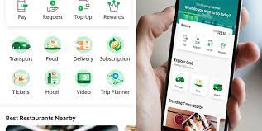
GOJEK Services
GRAB Services
Gojek/ Grab as a service provider for online transportation services, freight forwarding services, online shopping services, credit-billing services, personal care services, and so on.

Slide 22
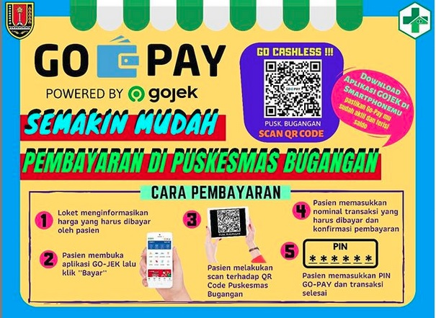
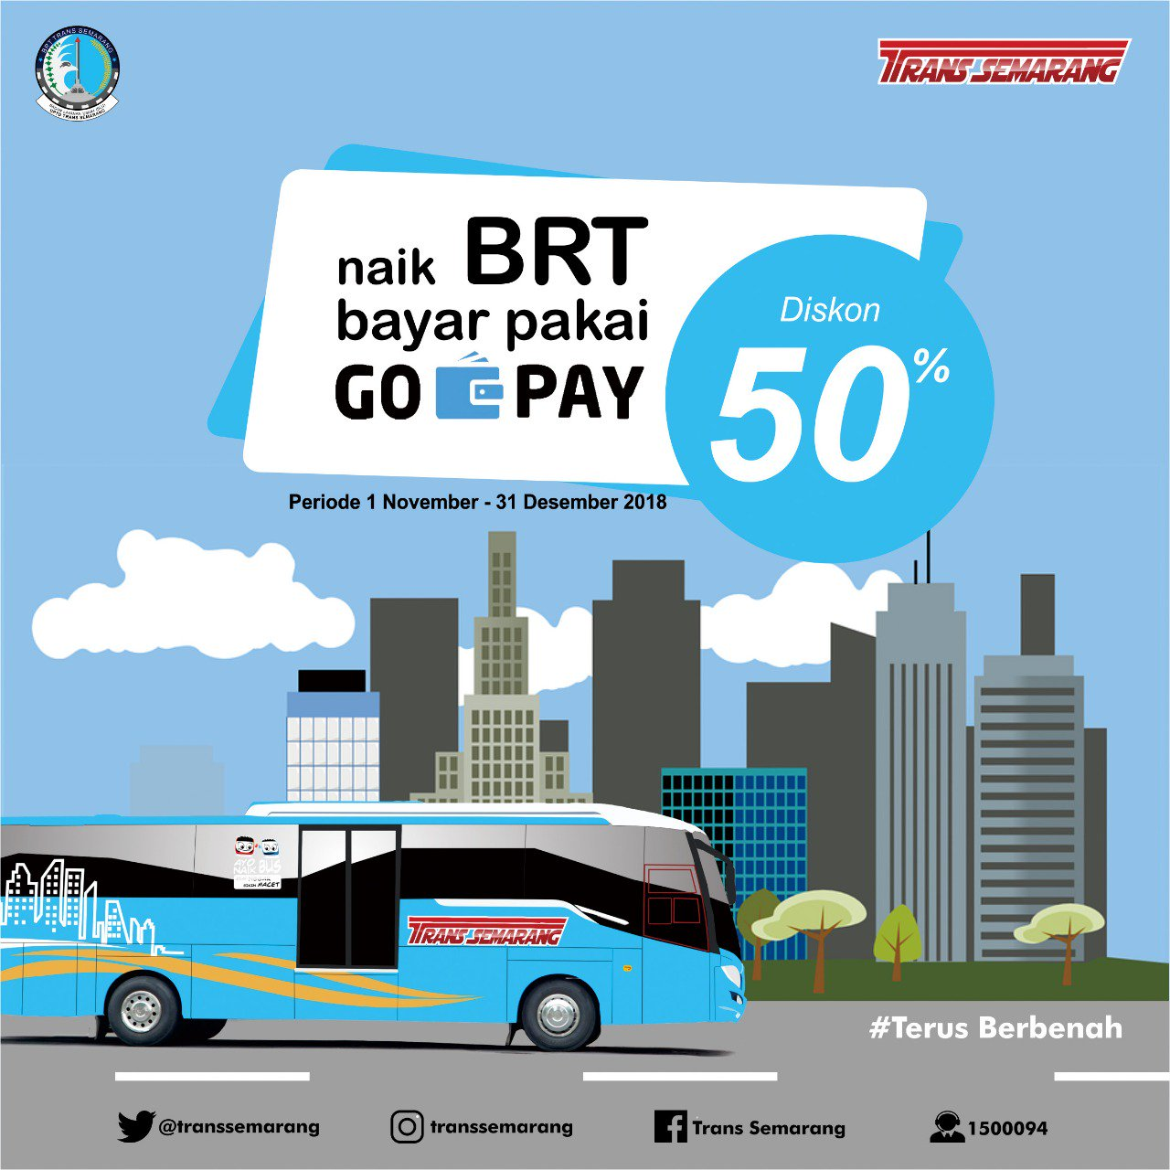
COOPERATION WITH ONLINE TRANSPORTATION SERVICE PROVIDER (GOJEK-GRAB) . . . ..
Cashless payment using Go-Pay on the Trans-Semarang Bus Rapid Transit (BRT) service, for health facilities, tourist destination, and also for payment of Land and Building Tax.

Slide 23
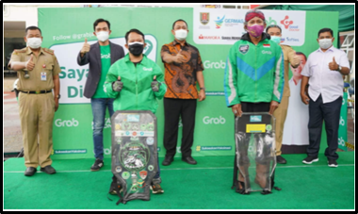
COOPERATION WITH ONLINE TRANSPORTATION SERVICE PROVIDER (GOJEK-GRAB) . . . ..
Grab provides a Grab vaccine Center using the Drive-Thru method for two wheeled vehicles, as well as walk-in for 10,000 MSMEs, Public Workers in the transportation sector (Partners for Grab Drivers and Delivery), and also for the elderly in Semarang City.

Slide 24
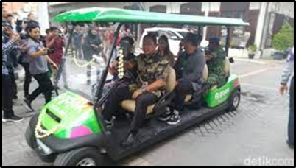
COOPERATION WITH ONLINE TRANSPORTATION SERVICE PROVIDER (GOJEK-GRAB) . . . ..
Gojek provided Golf Carts in Semarang Old Town to pick up visitors from the parking lot, in order to increase the comfort and discipline of the visitors, as well as reduce vehicle polution

Slide 25
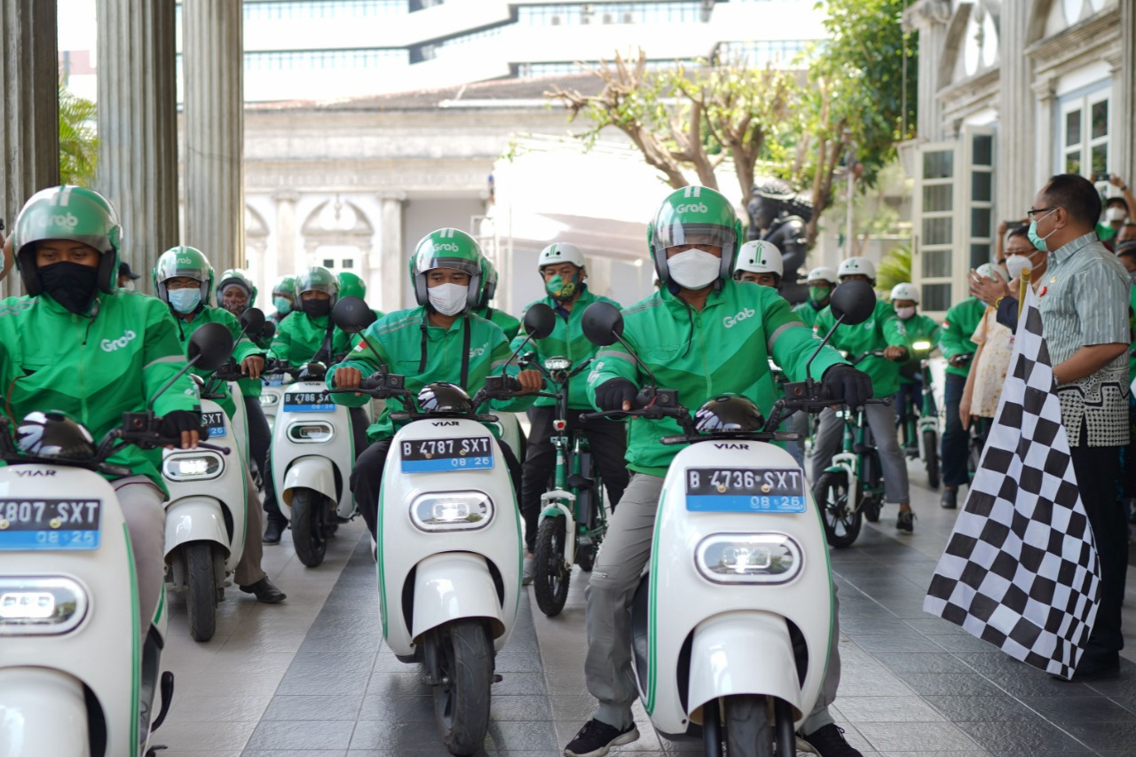
COOPERATION WITH ONLINE TRANSPORTATION SERVICE PROVIDER (GOJEK-GRAB) . . . ..
Provision of electric motorbikes by Grab for Driver Partners

Slide 26
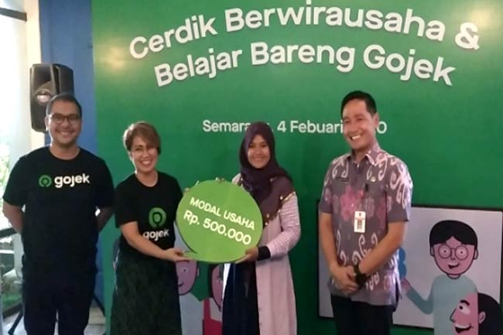
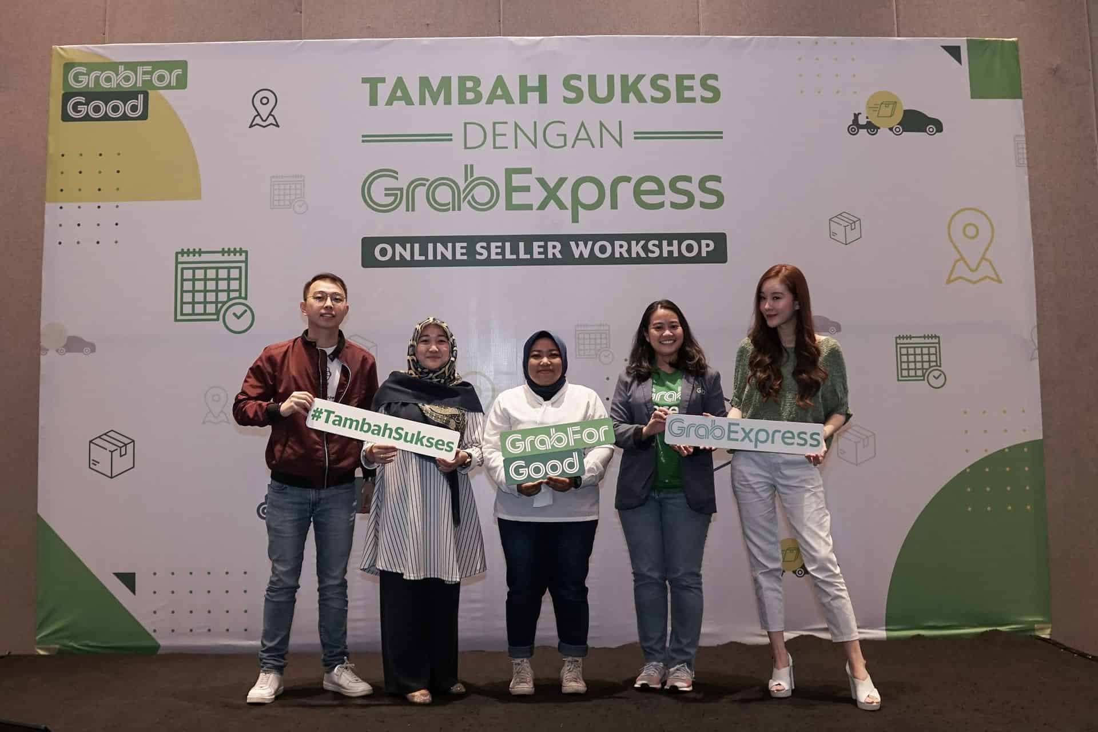
COOPERATION WITH ONLINE TRANSPORTATION SERVICE PROVIDER (GOJEK-GRAB) . . . ..
Micro, Small, Medium Enterprises (MSME) training by Gojek and Grab

Slide 27
COOPERATION WITH ONLINE TRANSPORTATION SERVICE PROVIDER (GOJEK-GRAB) . . . ..
Challenge/ Obstacle :
The existence of Gojek/Grab using conventional vehicles is not in line with the urban green concept
Solution :
There has been no massive action to manage this problem, it is only limited to providing electric motorcycle to a small number of online motorbike drivers.

Slide 28


THANK YOU

